Slide 1


jenkins
Chilukuri Saipujitha
200115

Slide 2
contents
Spring boot
Selenium
GitHub
Jenkins
Eclipse

Slide 3
introduction
Spring is an open-source lightweight framework widely used to develop enterprise applications
Spring Boot is built on top of the conventional spring framework
The most important feature of the Spring Framework is dependency injection
Spring Boot helps to run locally on a device without an internet connection

Slide 4
Spring Initializr
Spring Initializr is a Web-based tool that generates the Spring Boot project structure
Modern IDEs have integrated Spring Initializr that provides the initial project structure.
Spring Initializr provides an extensible API to generate JVM-based projects,
It is used to inspect the metadata which used for generate projects, for instance to list the available dependencies and versions.

Slide 5
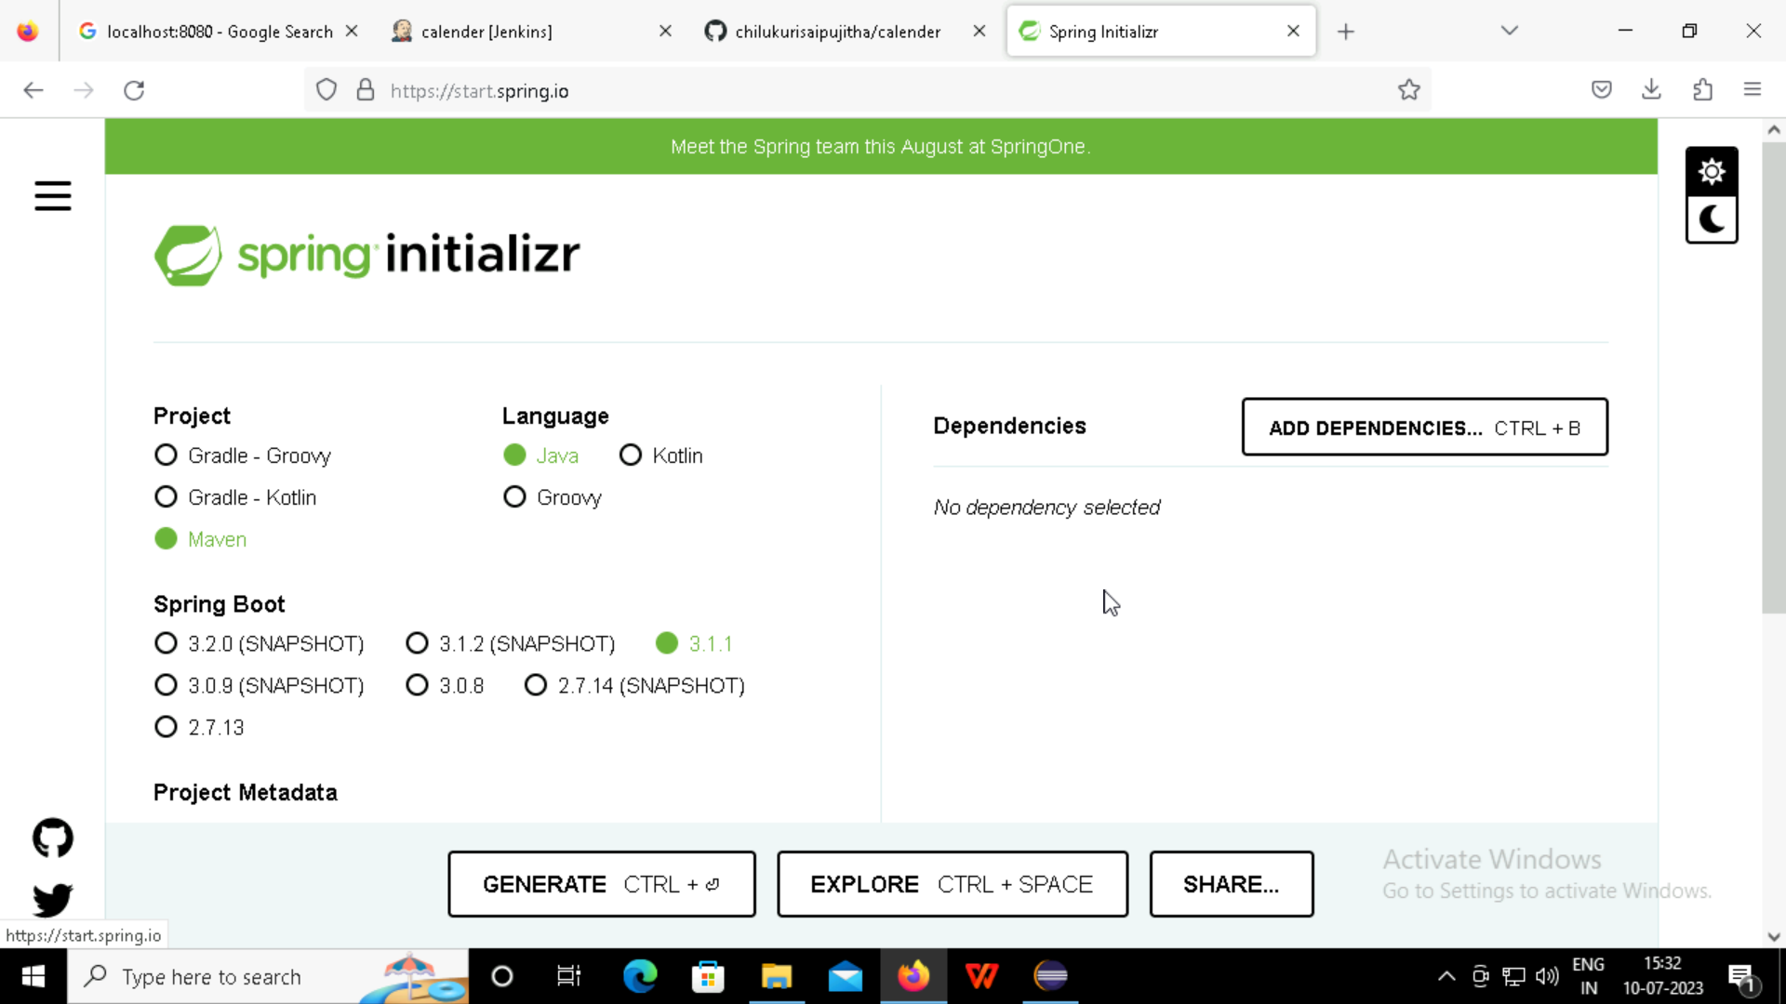

Slide 6
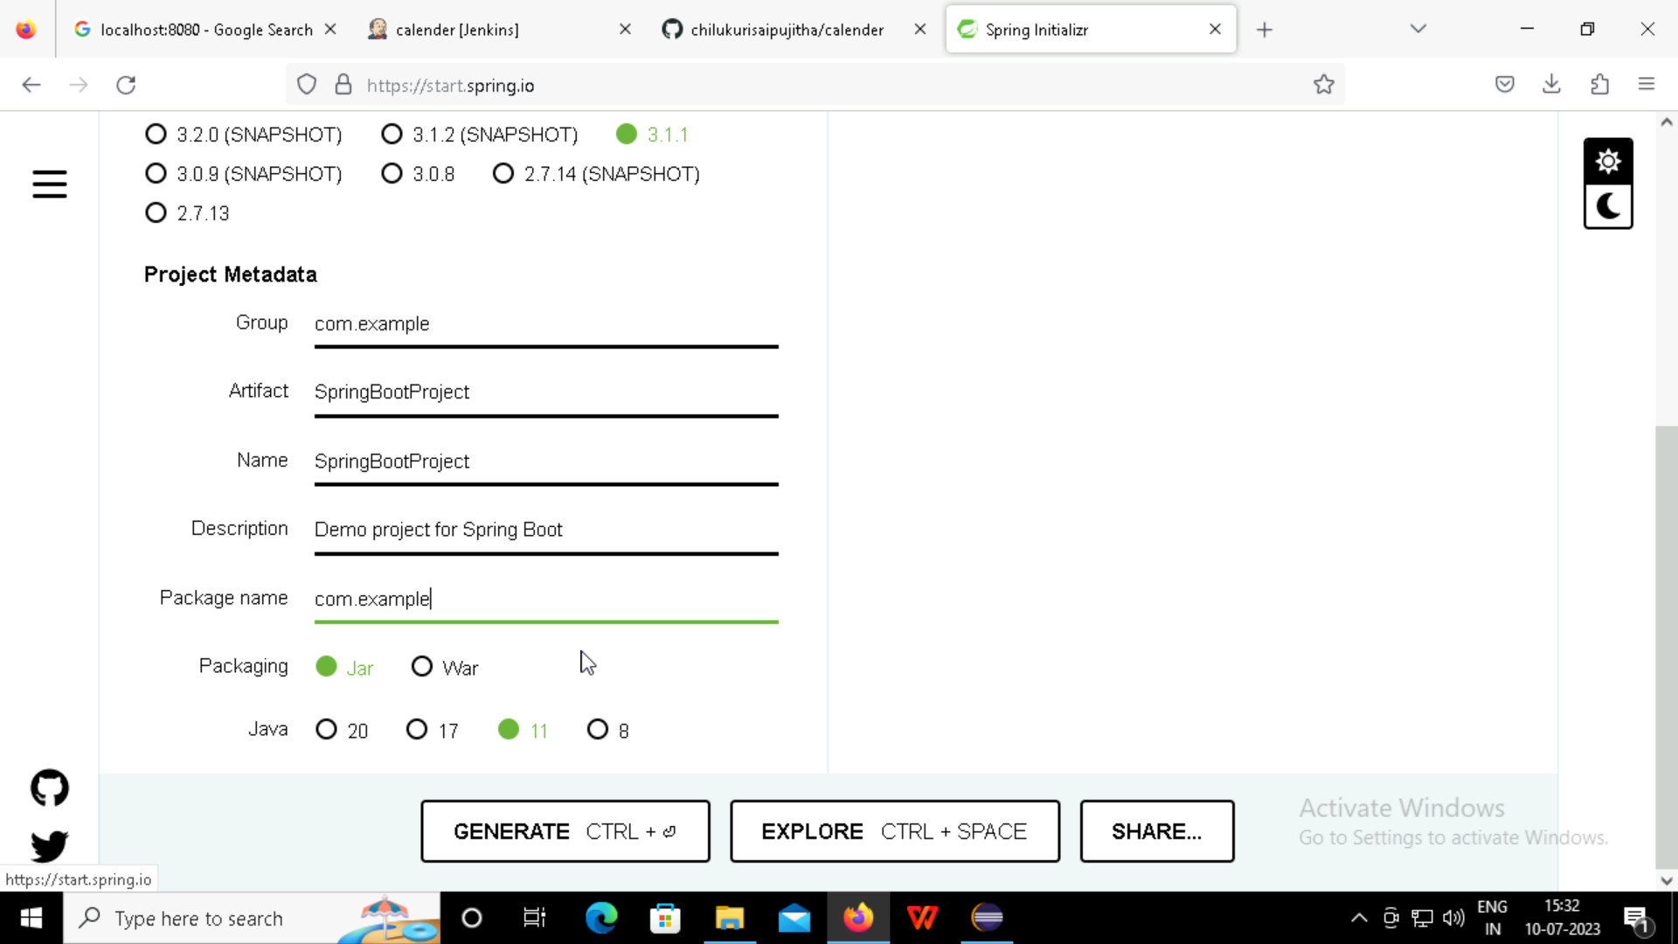

Slide 7
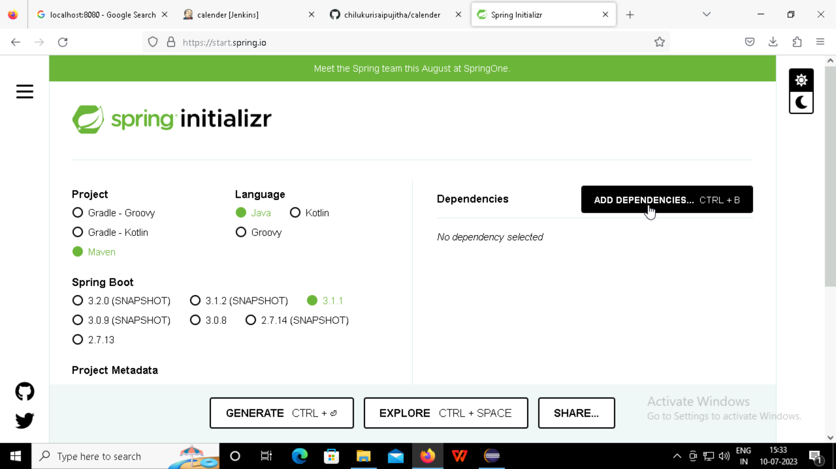

Slide 8
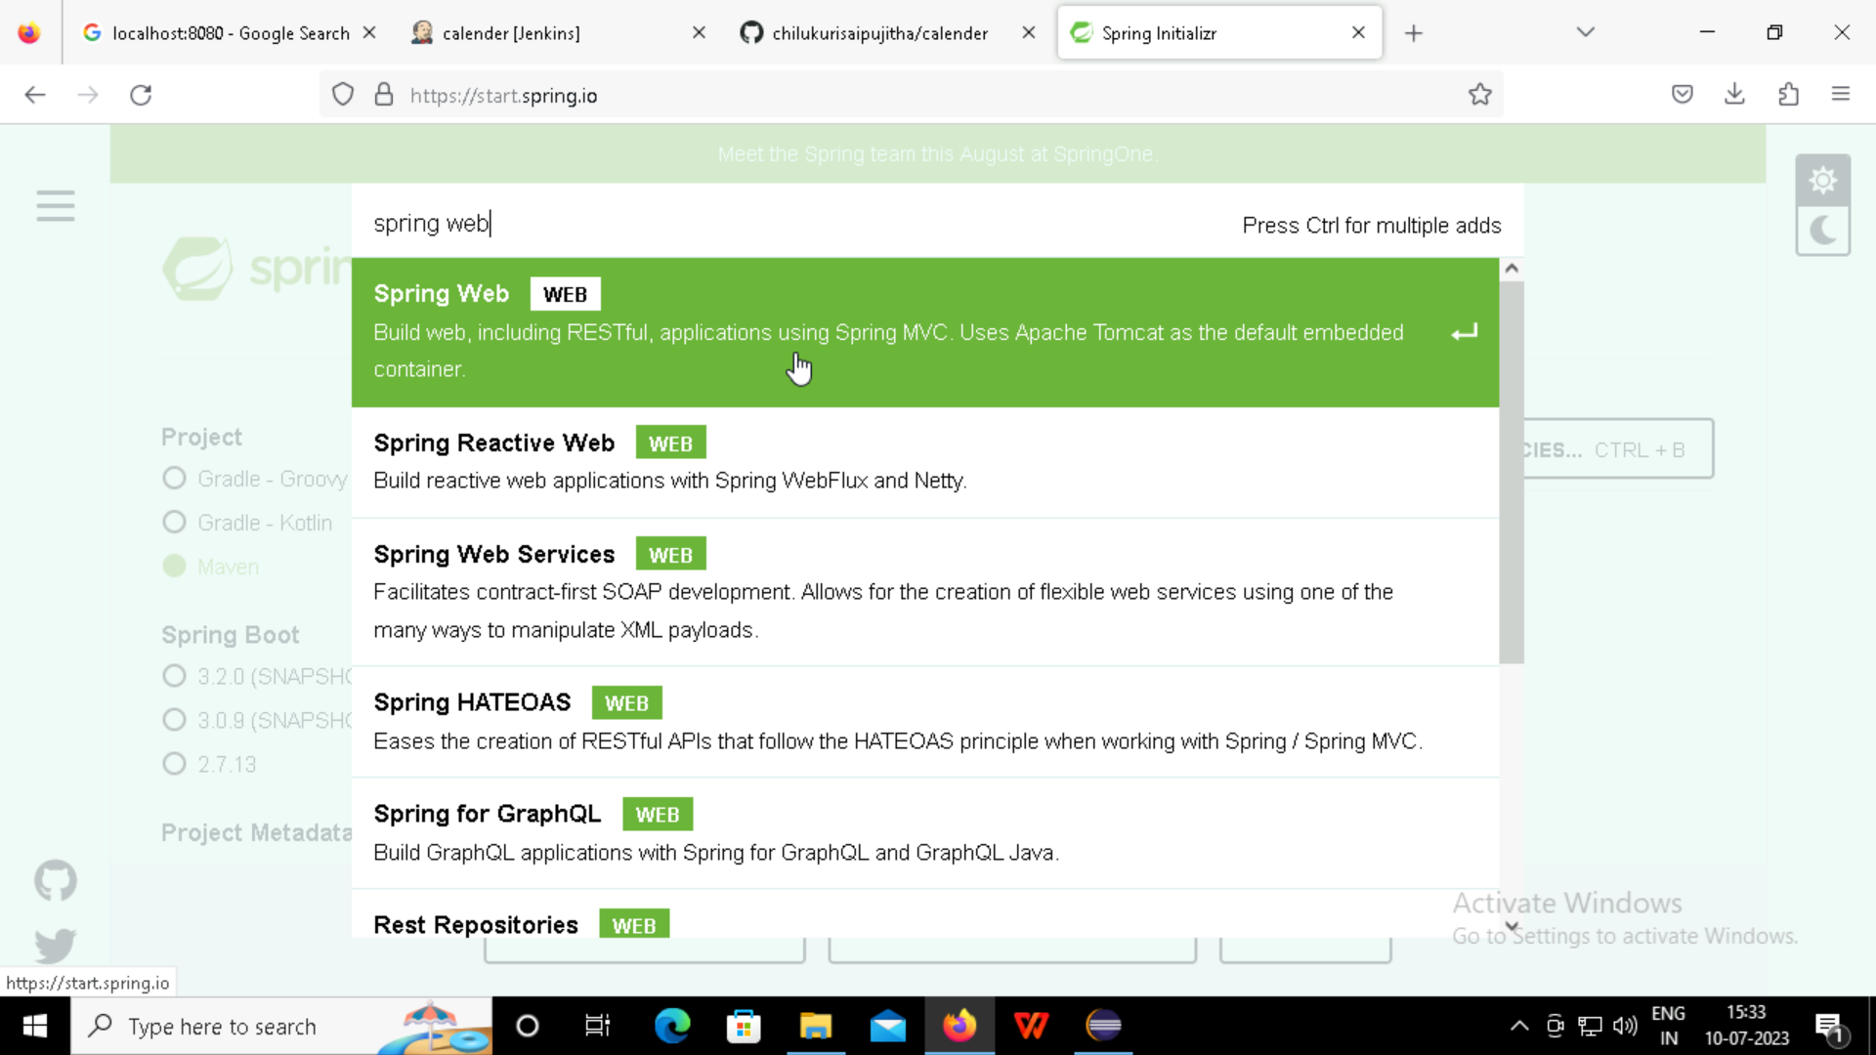

Slide 9
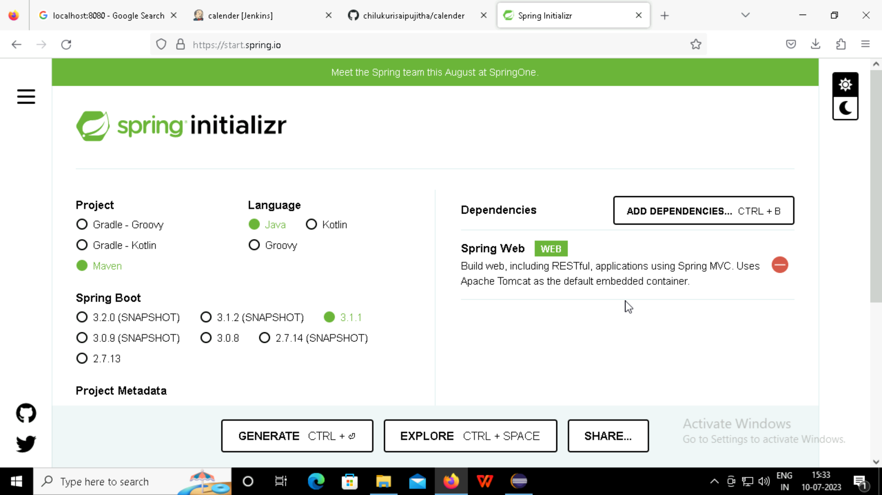

Slide 10
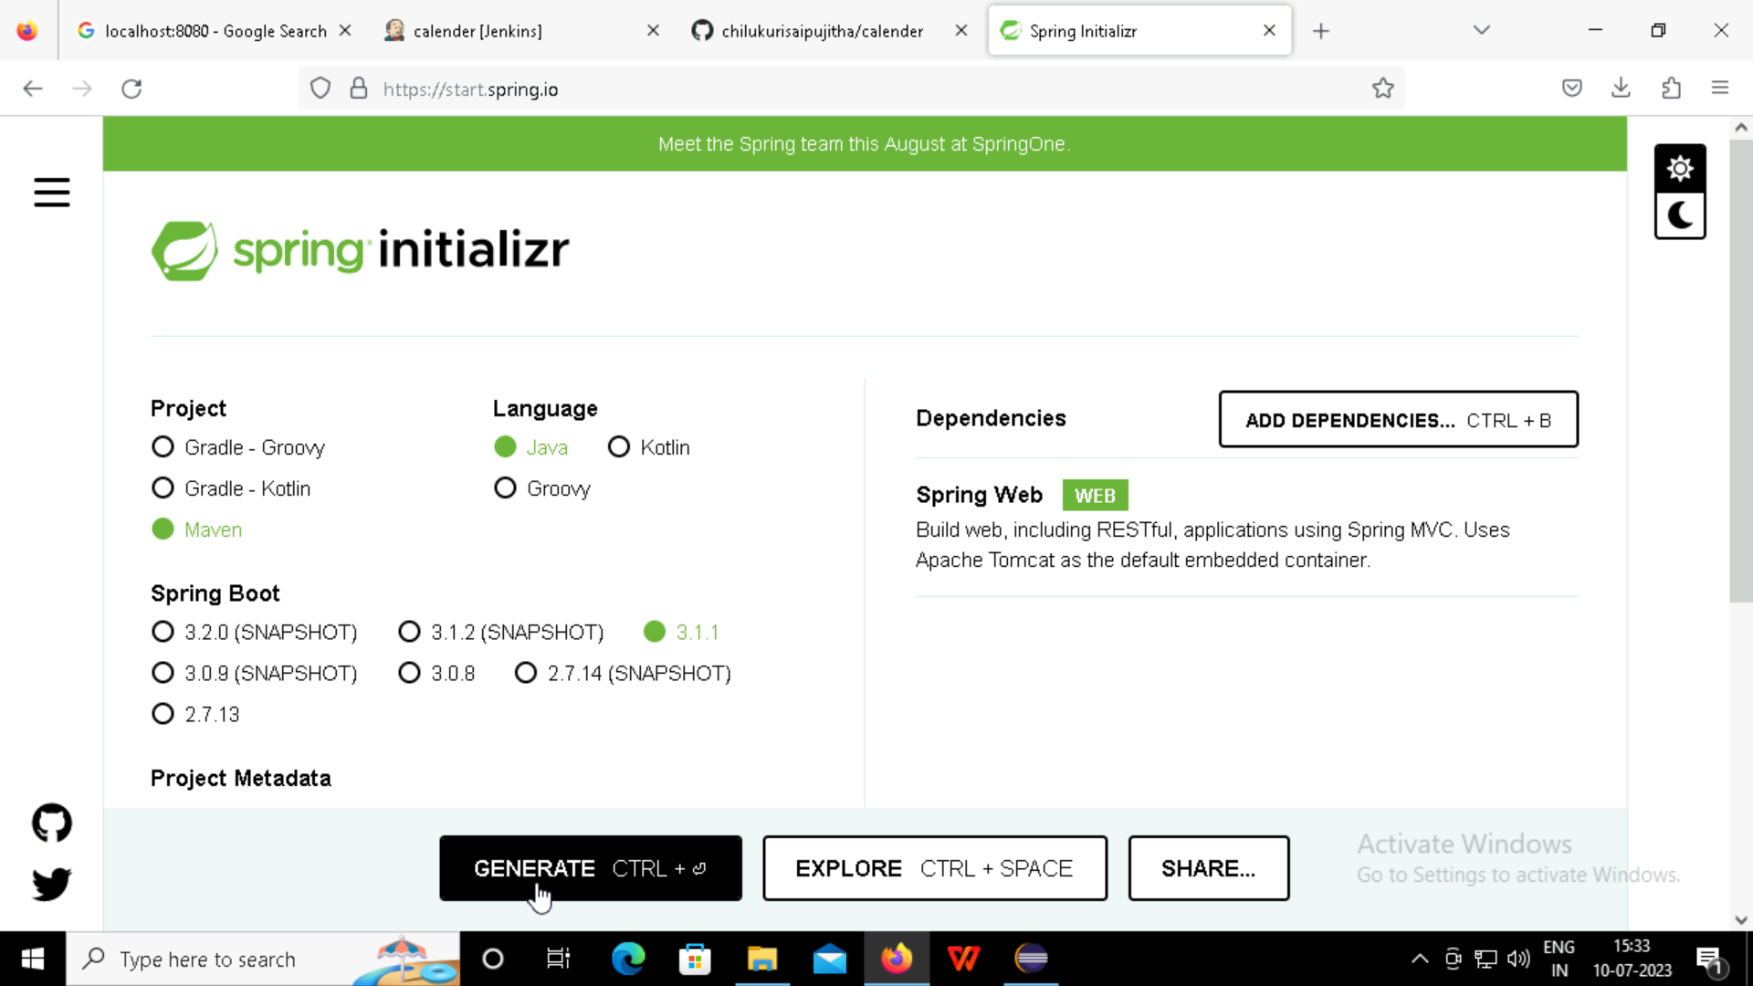

Slide 11
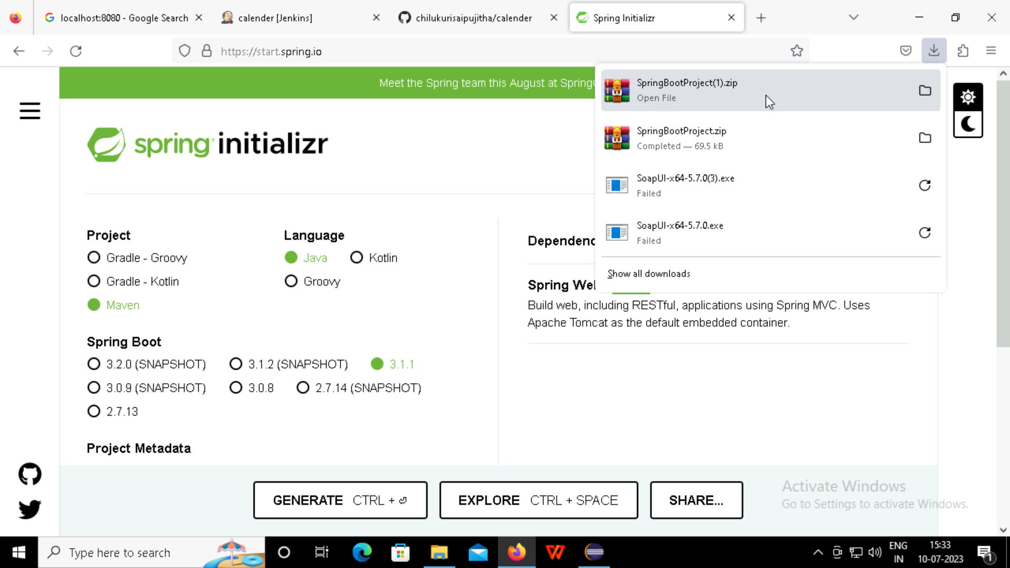
Zip file
Downloaded

Slide 12
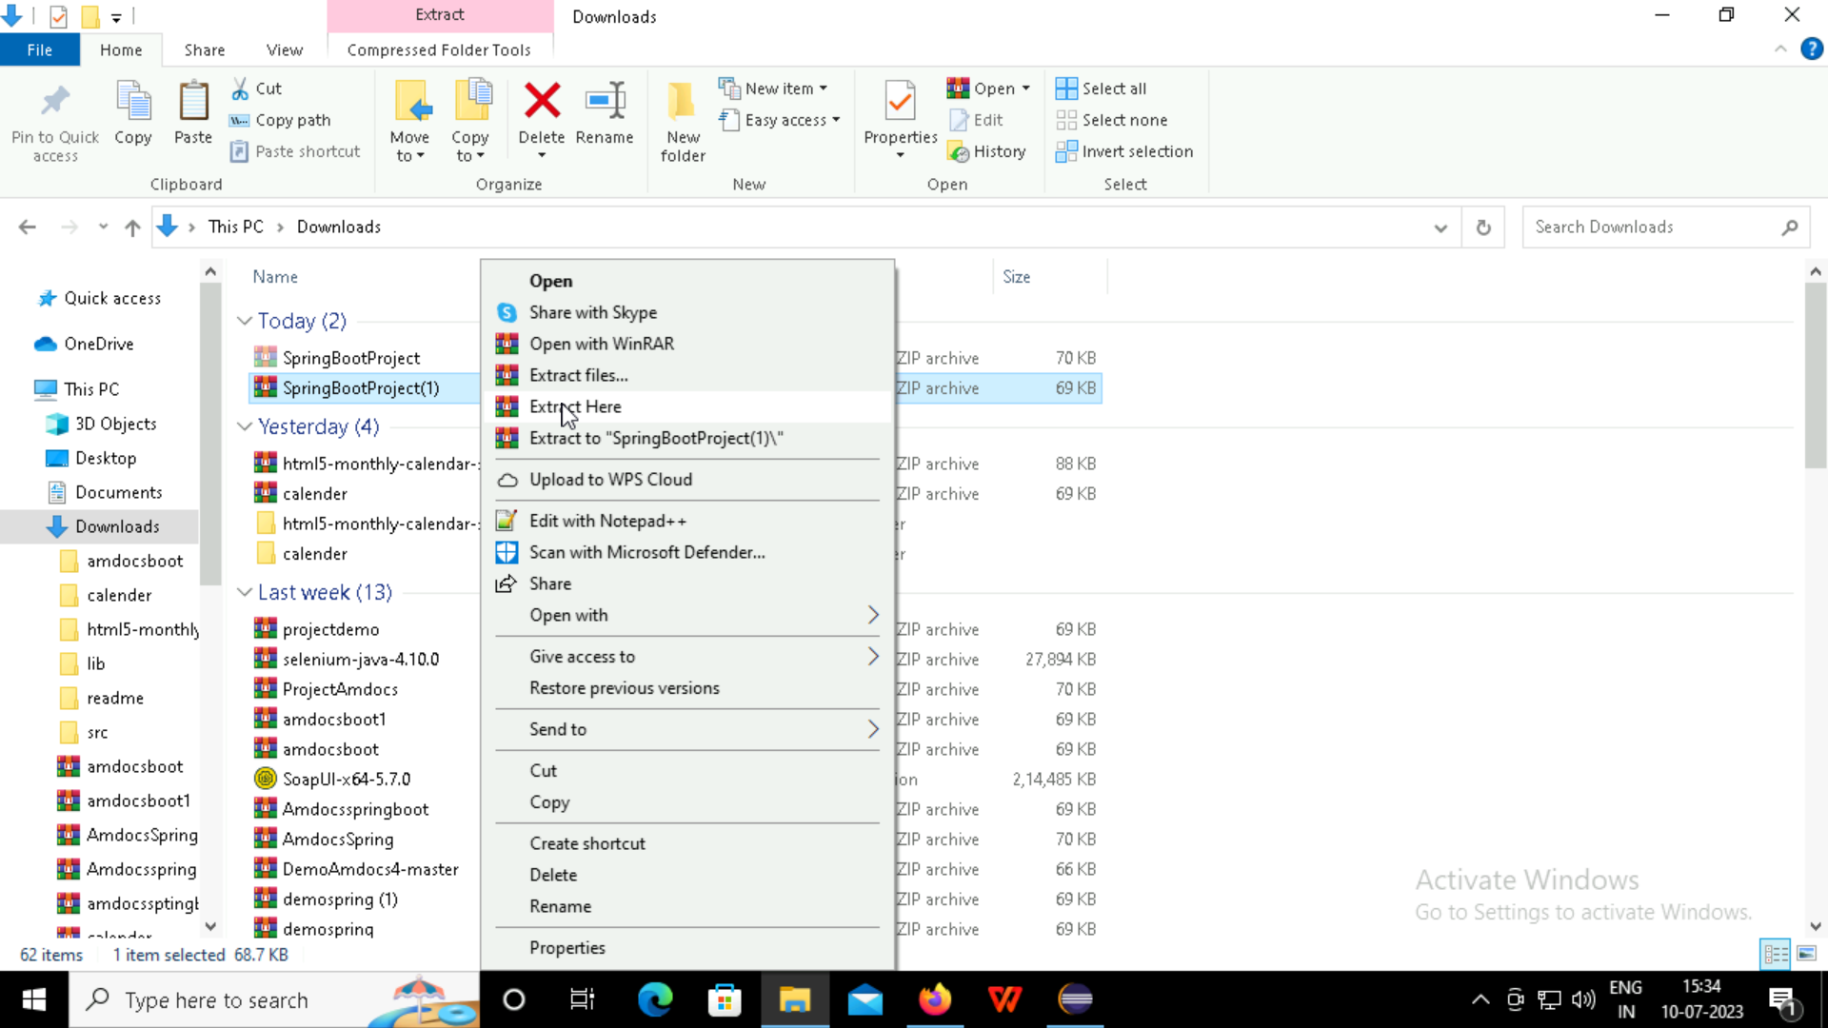

Slide 13
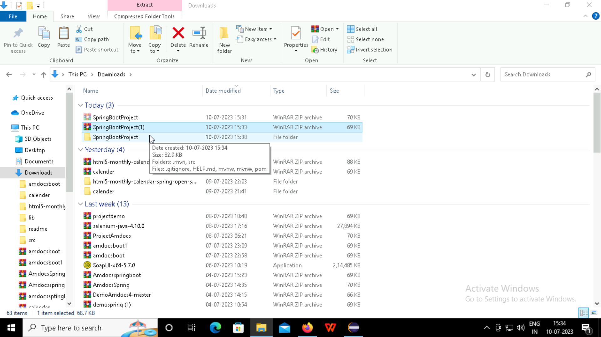
Downloaded file should be unzip

Slide 14
Eclipse

Slide 15
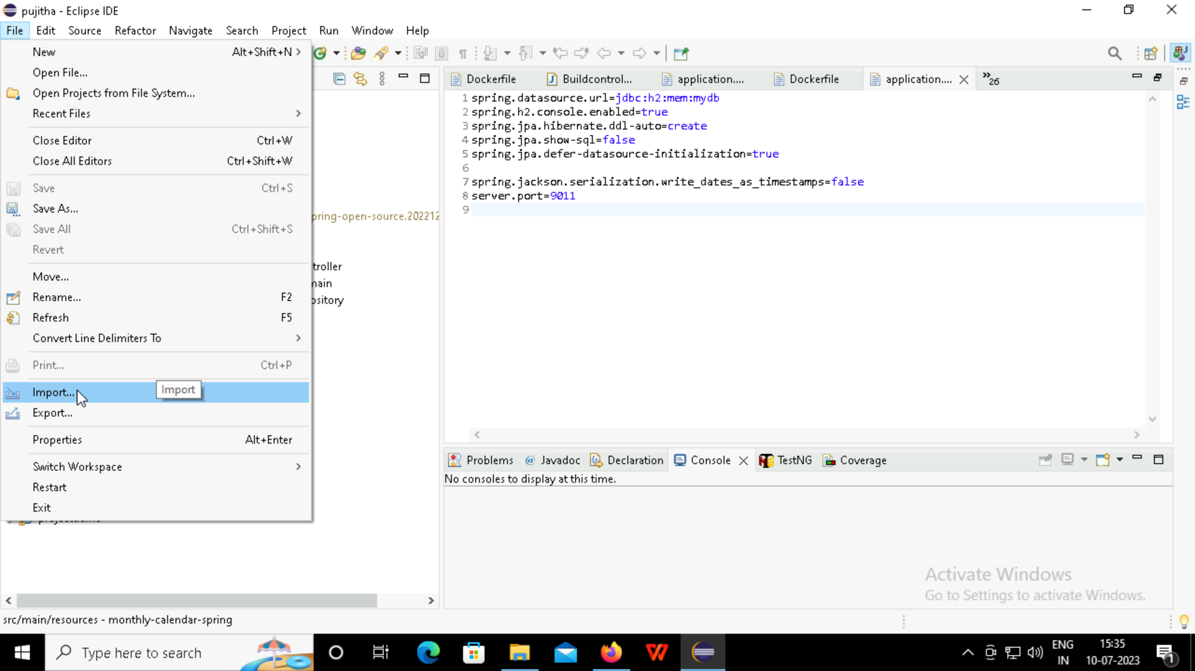

Slide 16
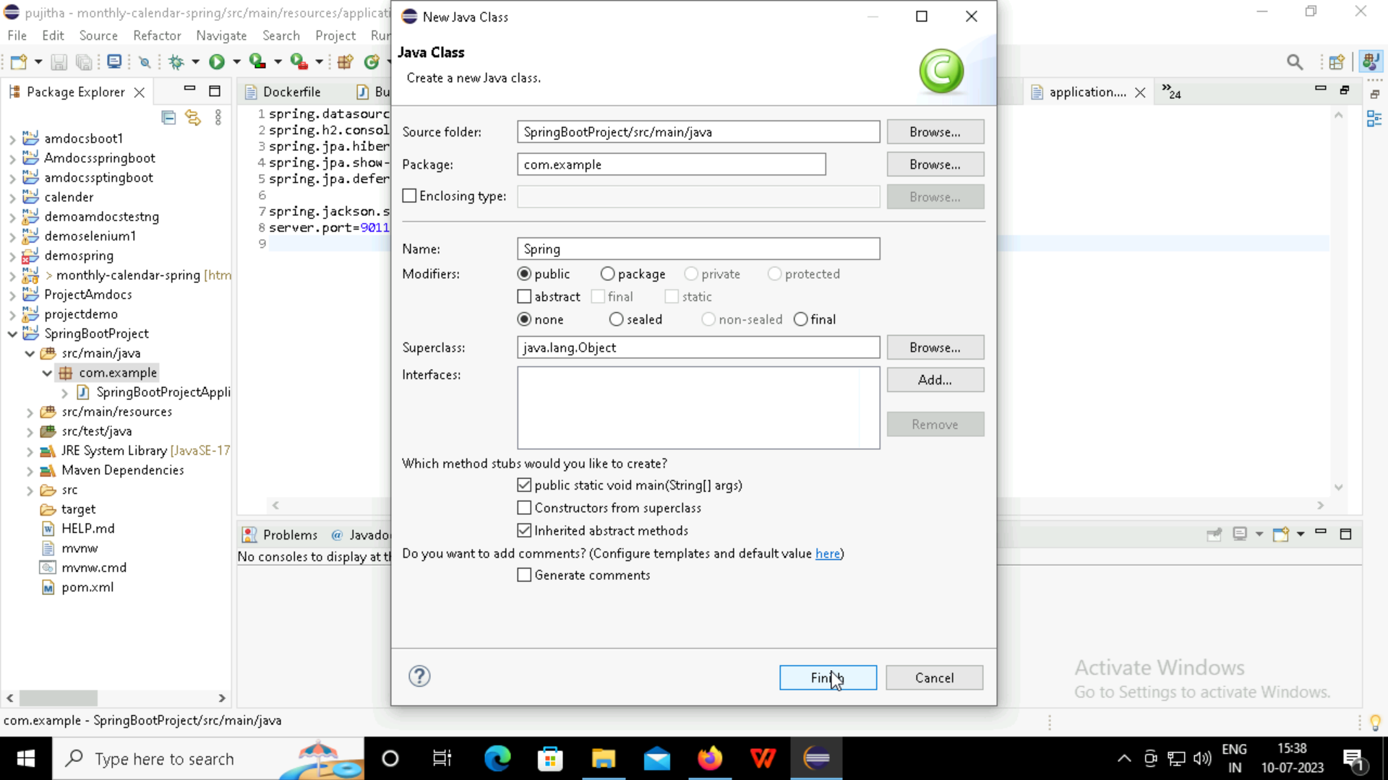

Slide 17
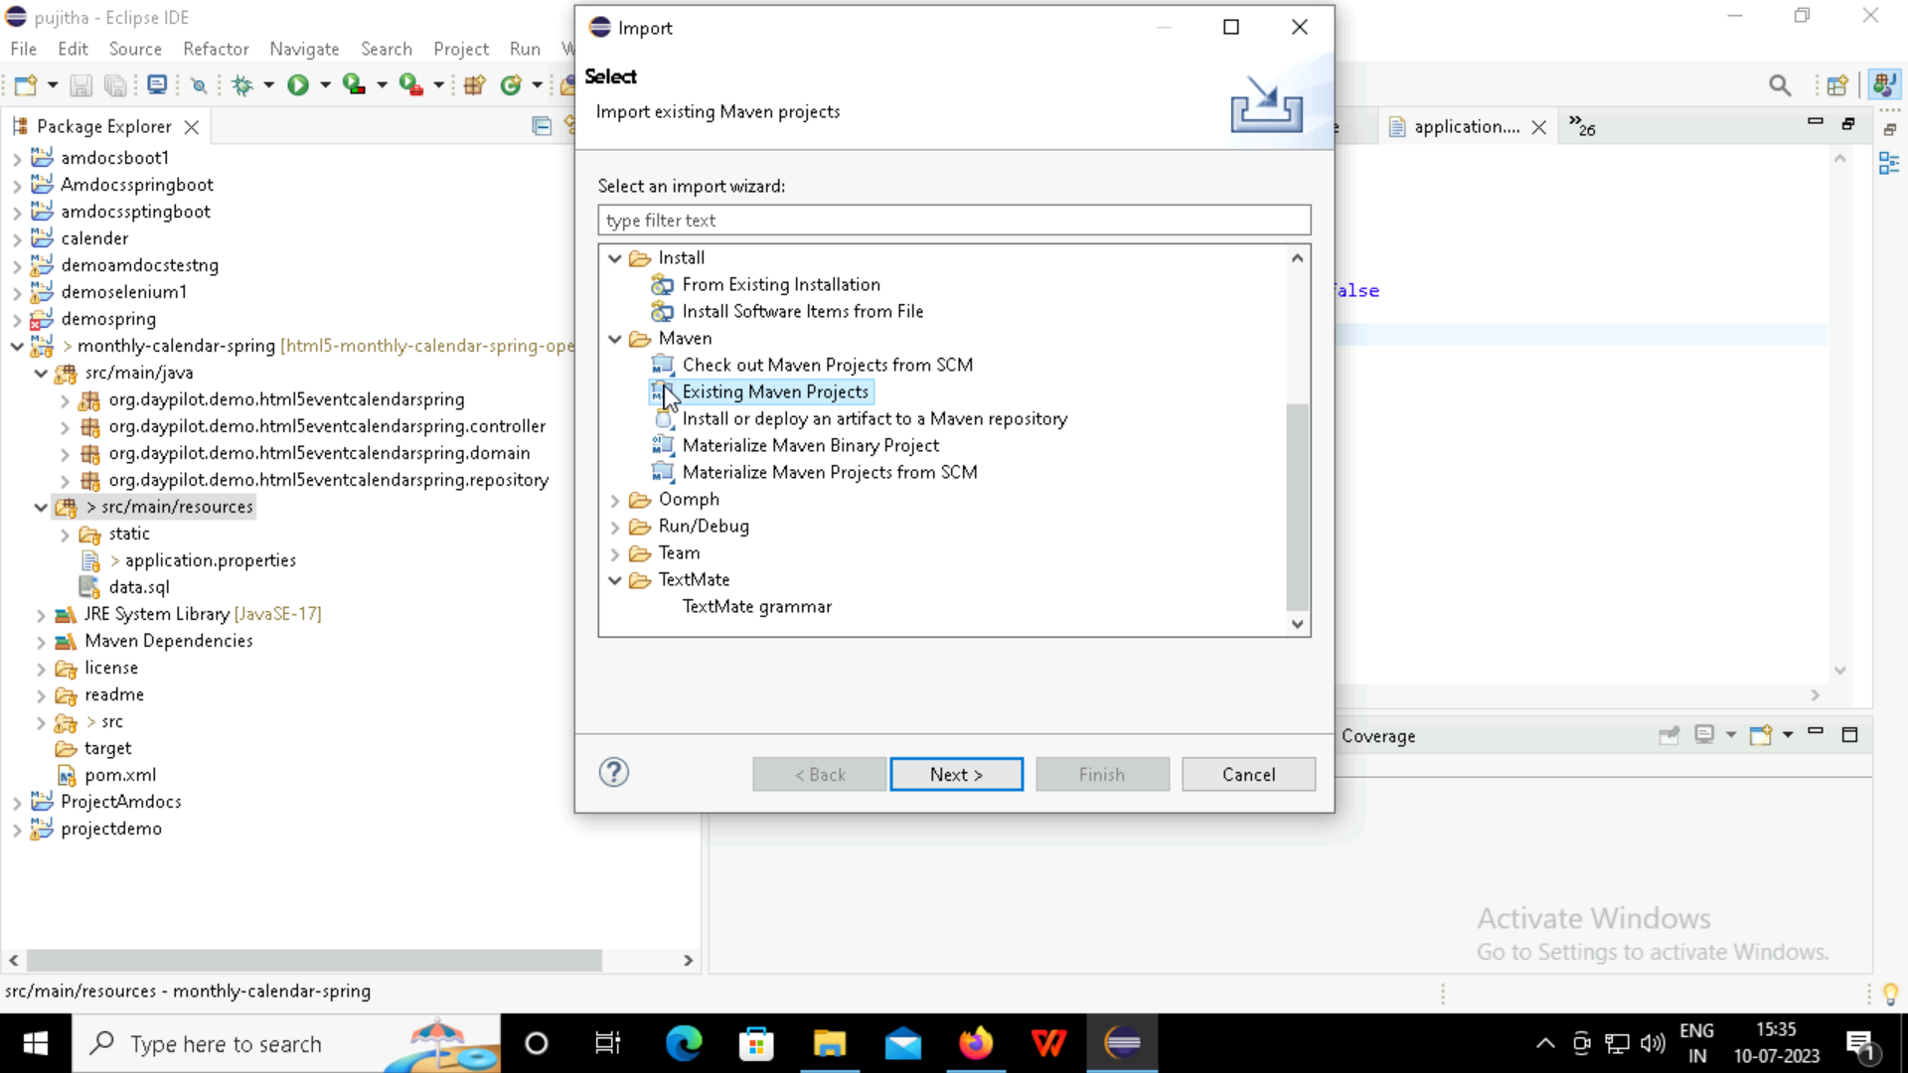

Slide 18
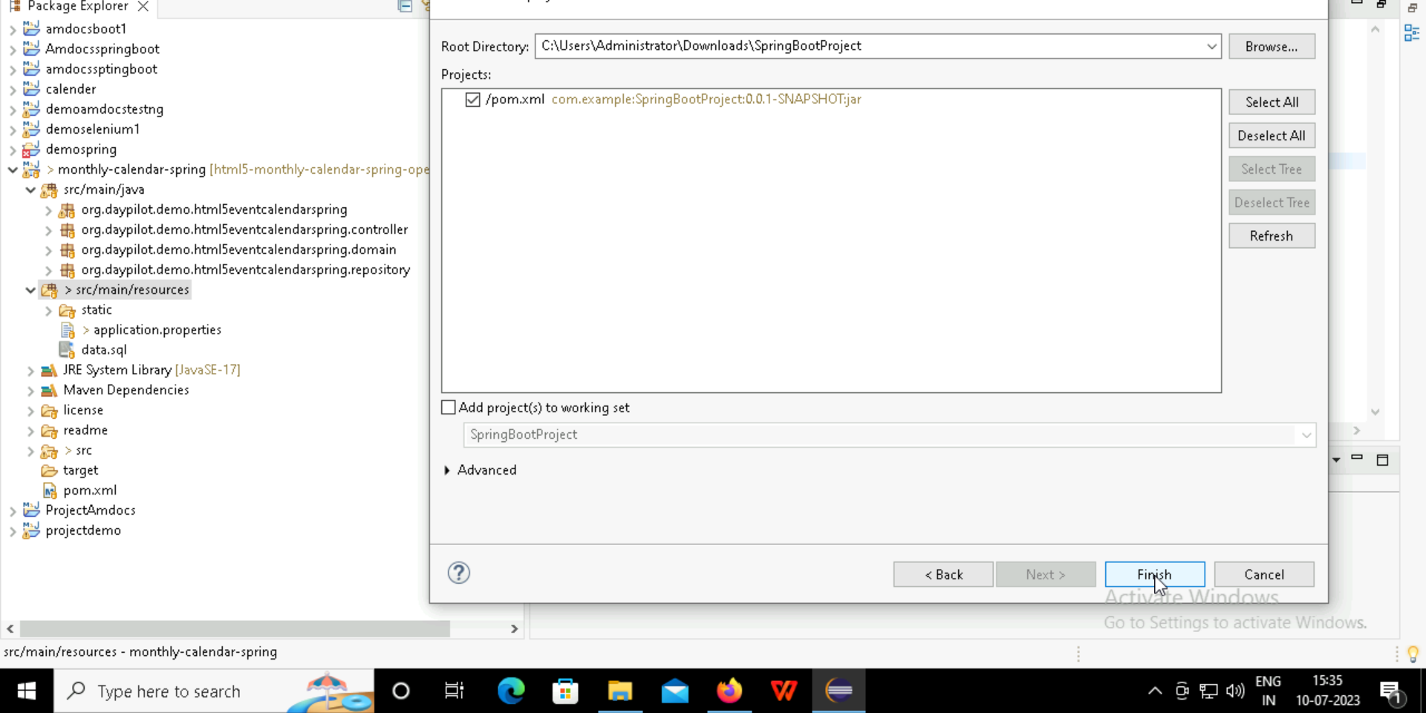

Slide 19
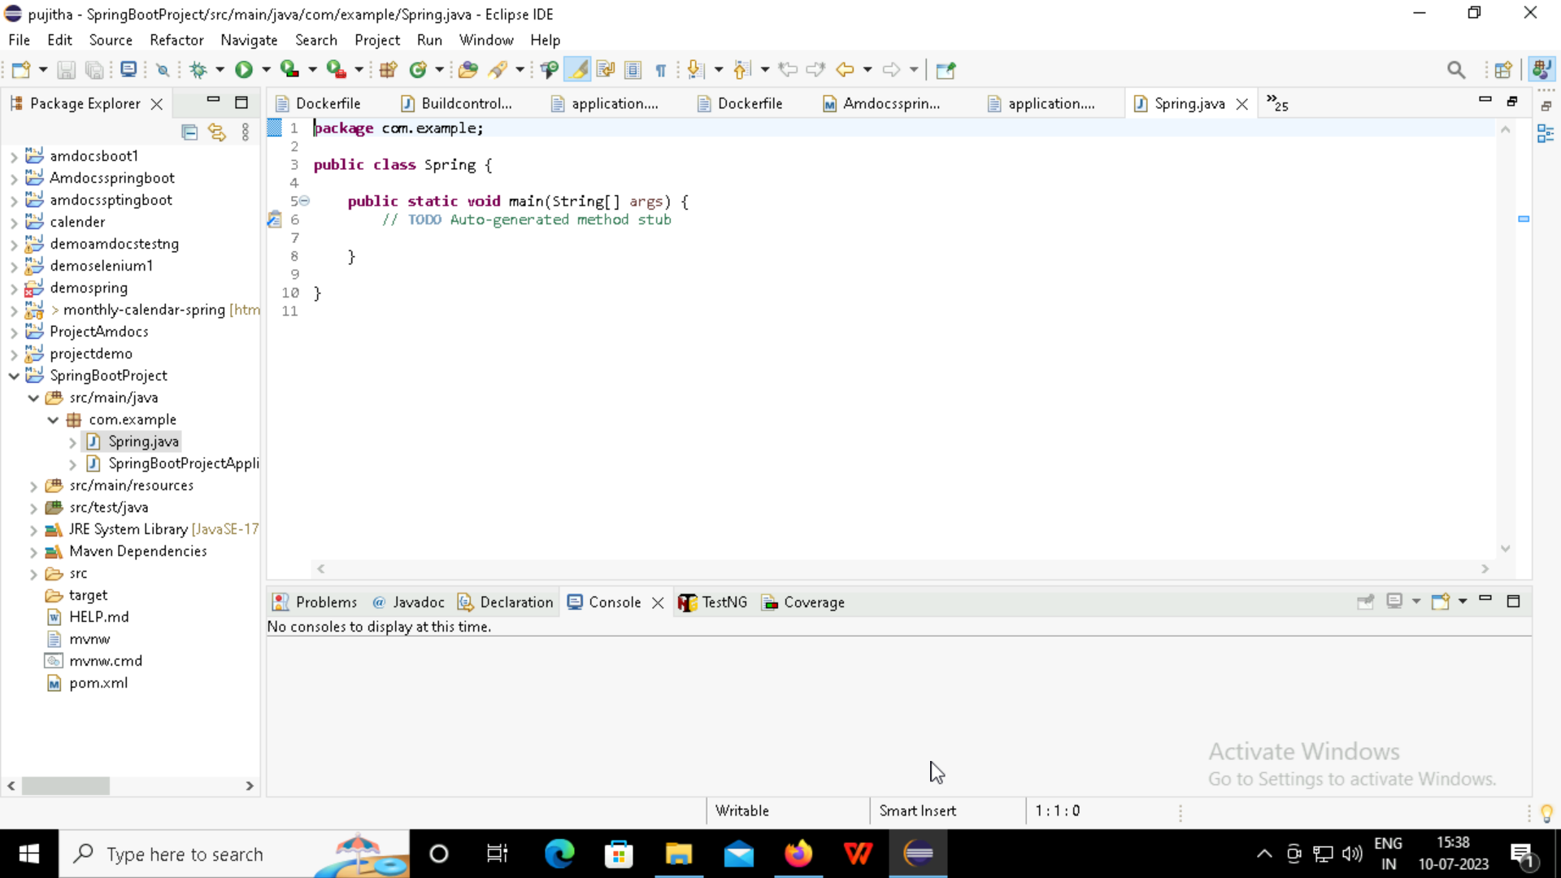

Slide 20
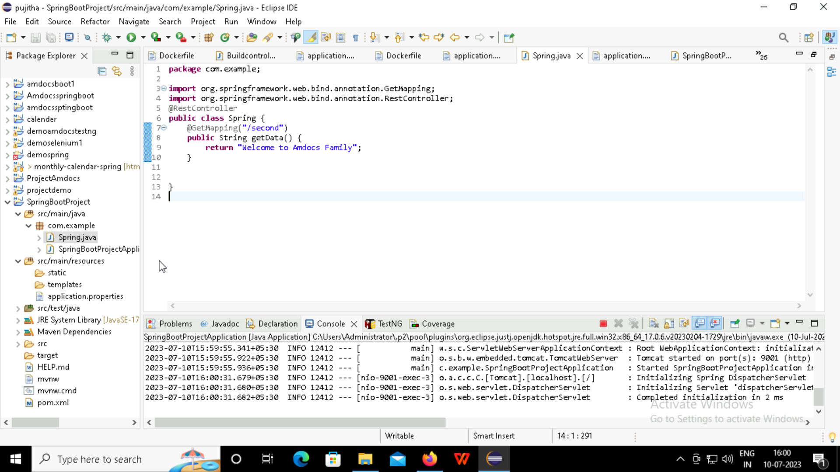

Slide 21
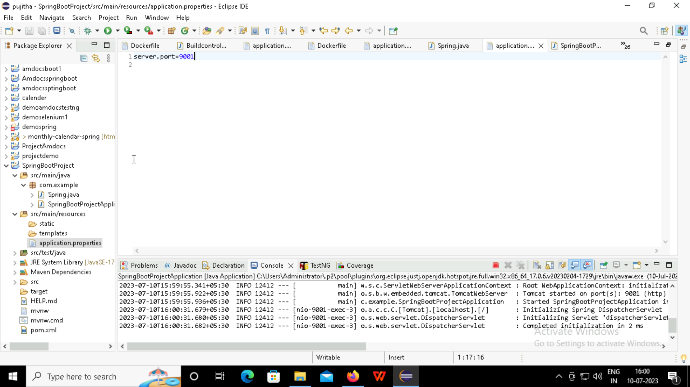

Slide 22
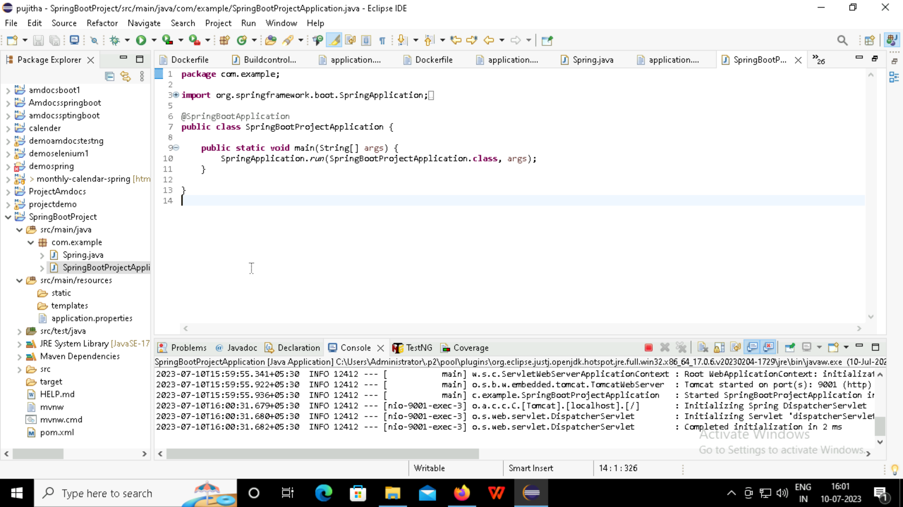

Slide 23
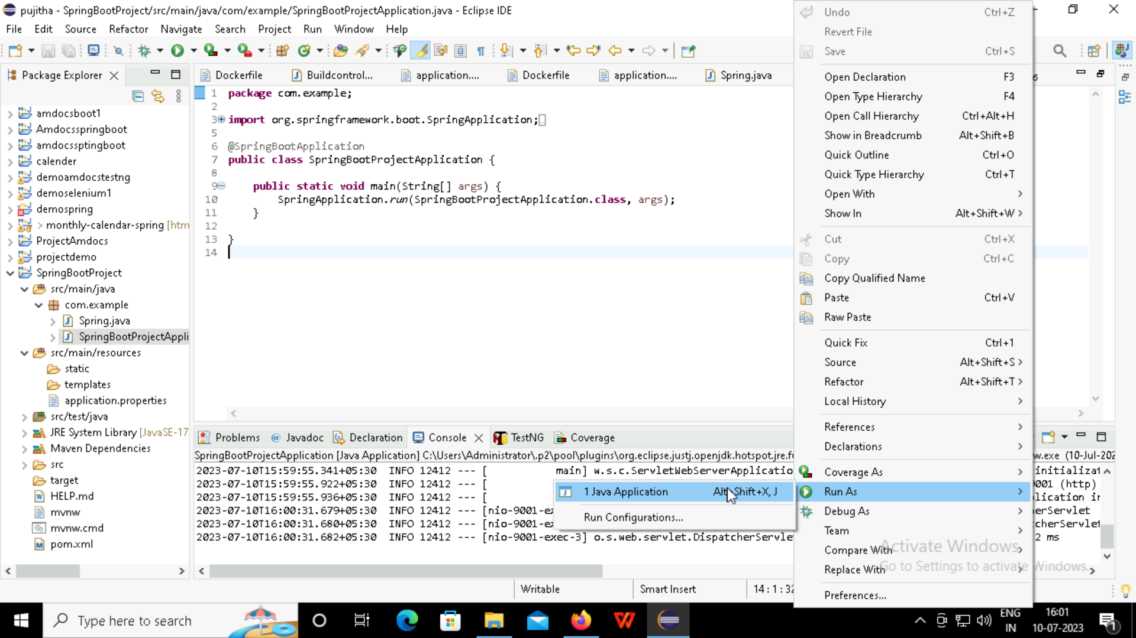

Slide 24
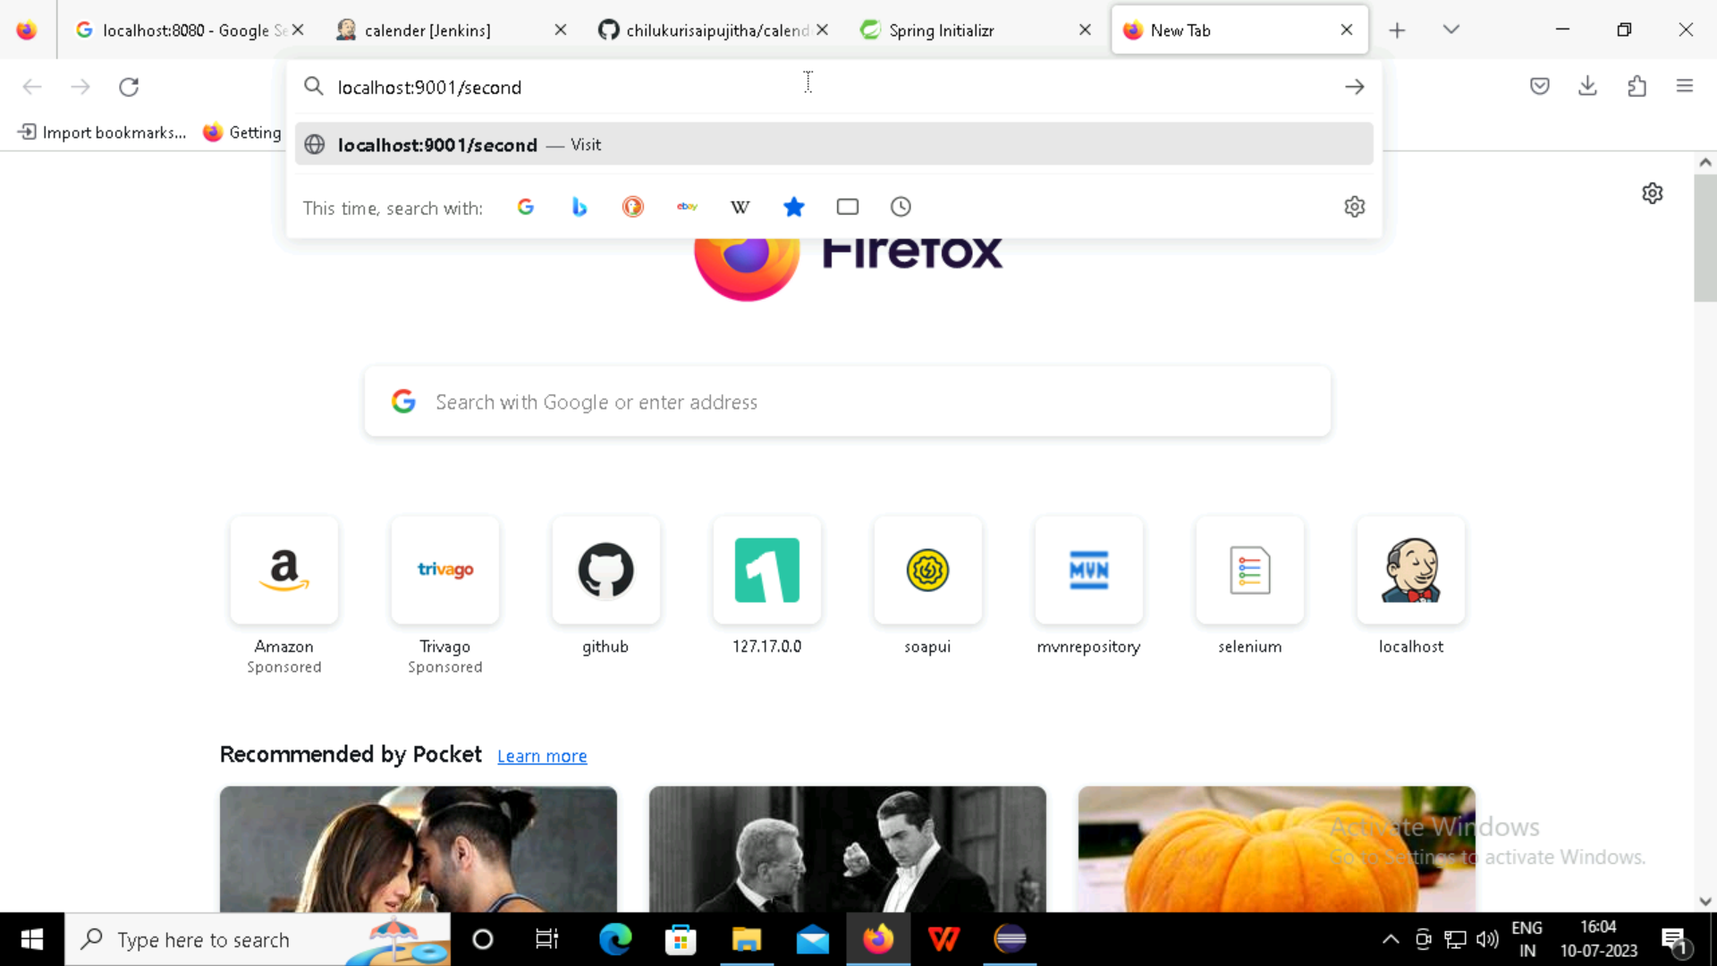
Using localhost to verify the output of the spring boot project

Slide 25
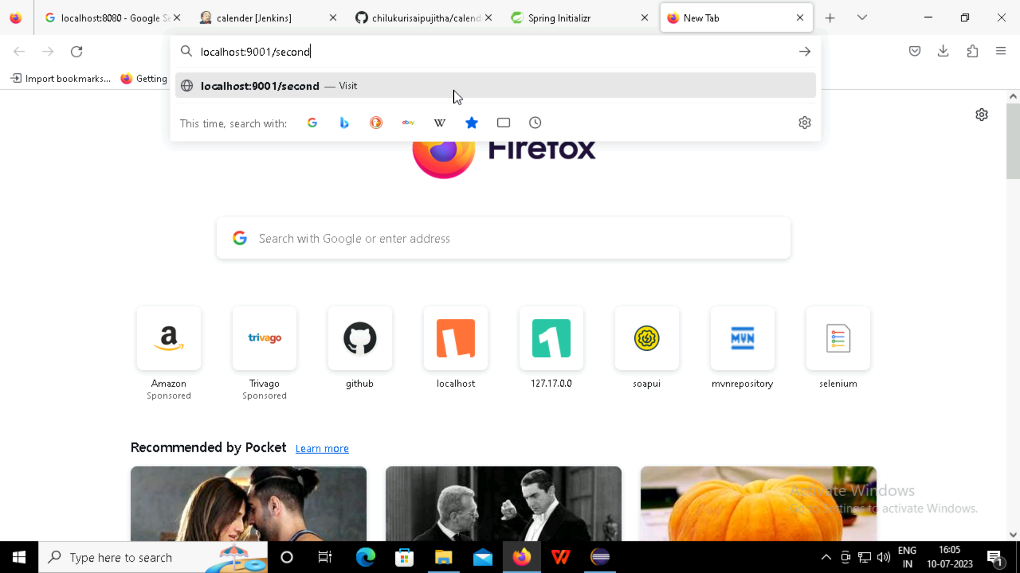

Slide 26
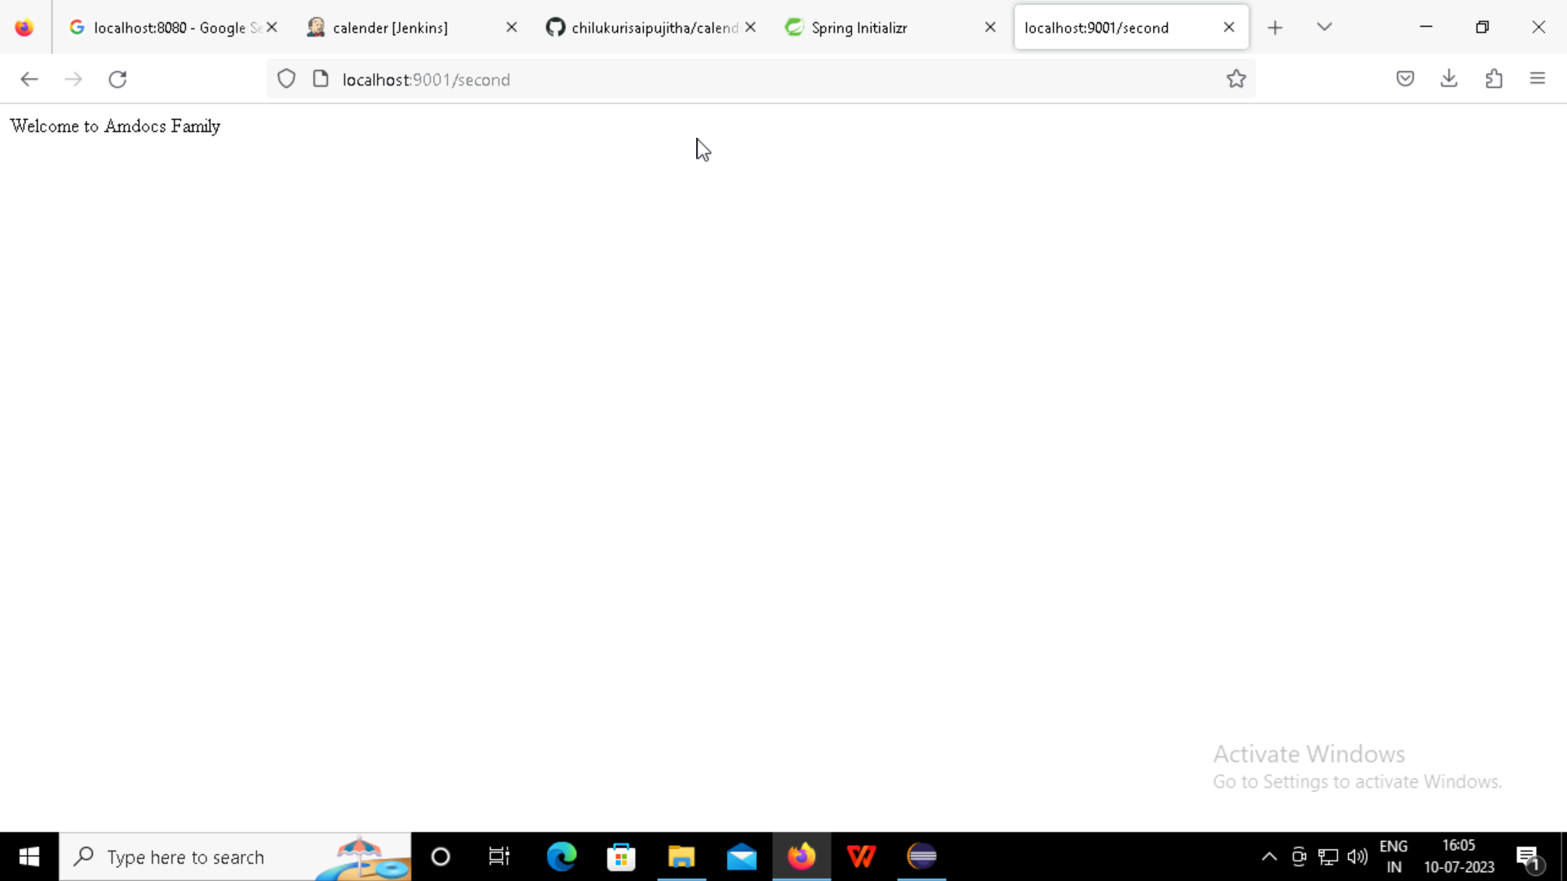
Output of the spring boot

Slide 27
Selenium
Selenium is an open-source tool that automates web browsers
It provides a single interface that lets you write test scripts in programming languages like Ruby, Java, Python

Slide 28
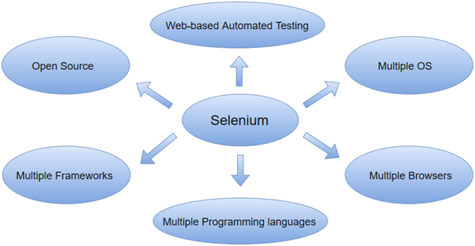
Selenium can be used to automate functional tests and can be integrated with automation test tools such as Maven, Jenkins, & Docker to achieve continuous testing.

Slide 29
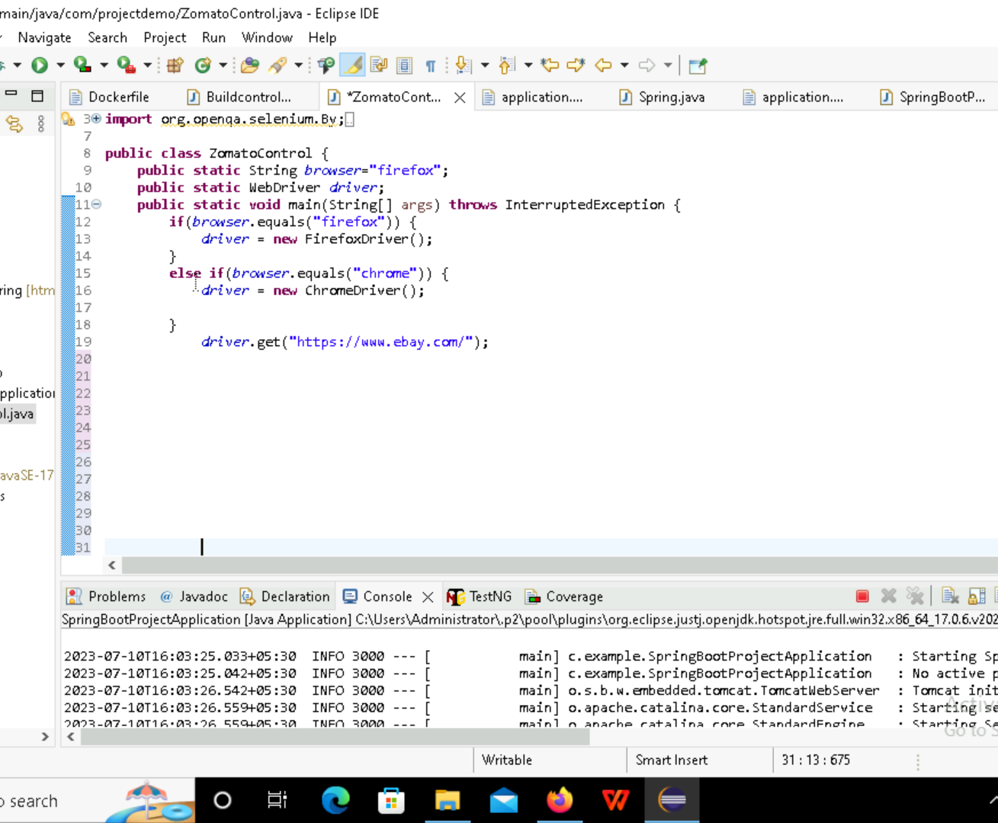
Automatic Opening the ebay Web Browser using Selenium

Slide 30
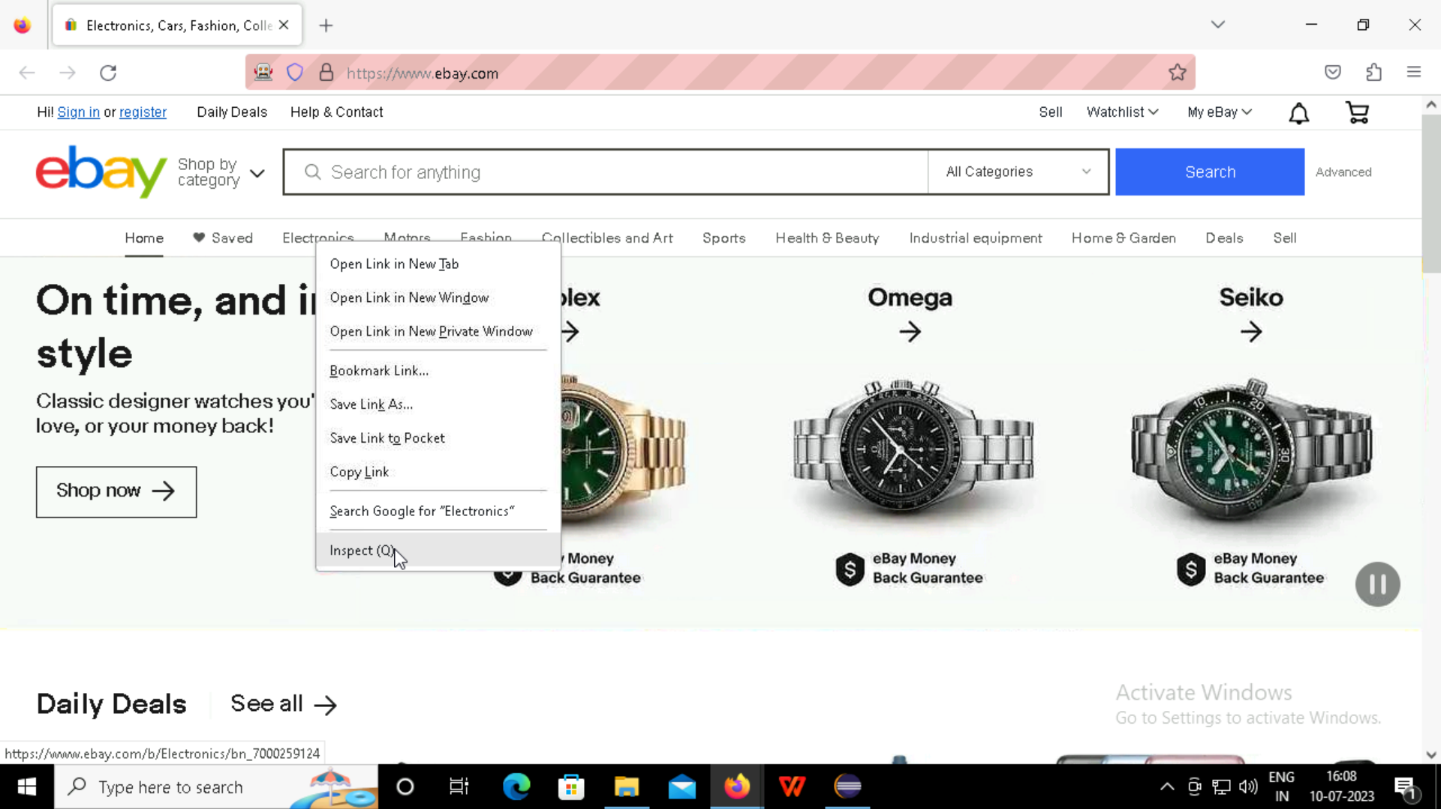

Slide 31
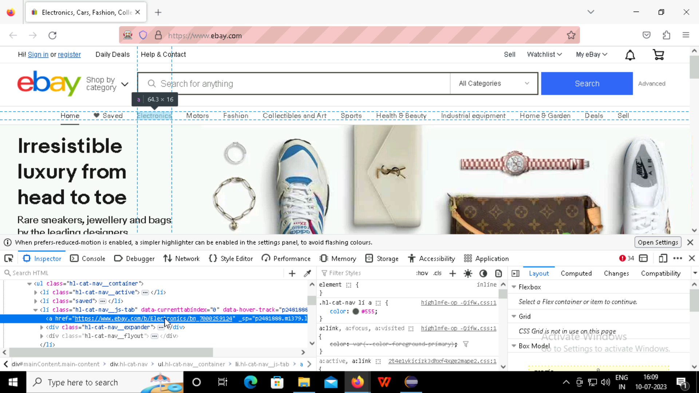

Slide 32
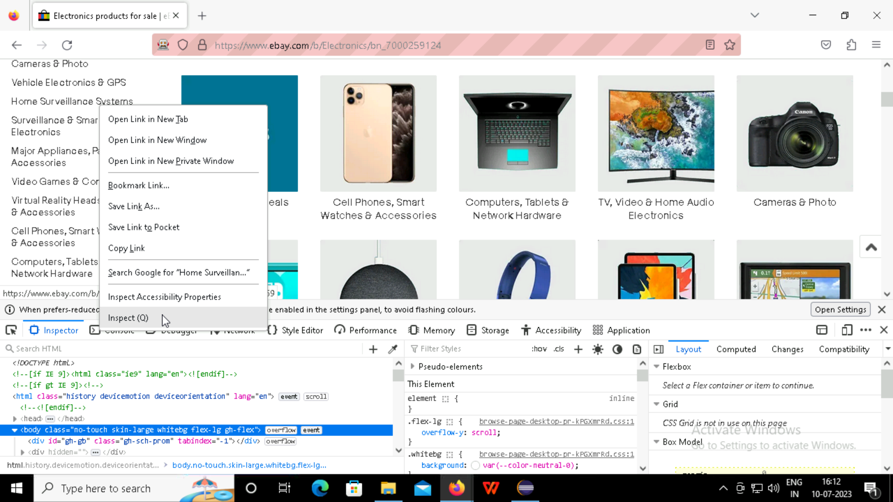

Slide 33
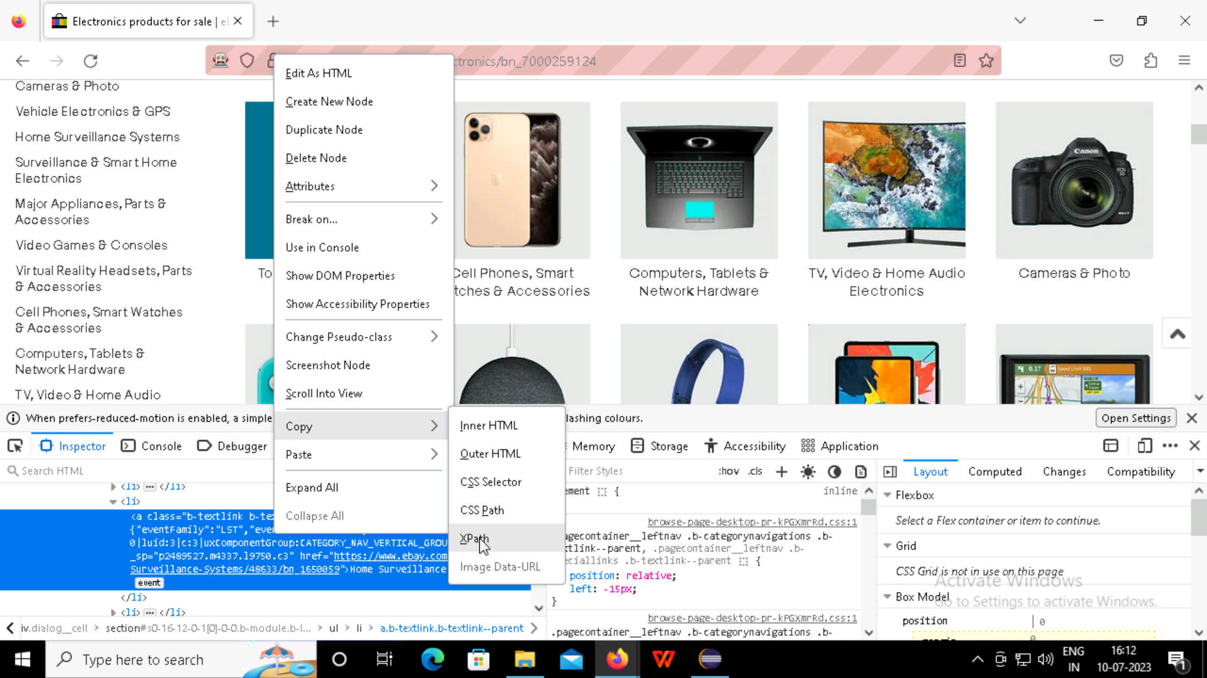
Xpath is to provide a flexible way of addressing the different parts of xml document

Slide 34
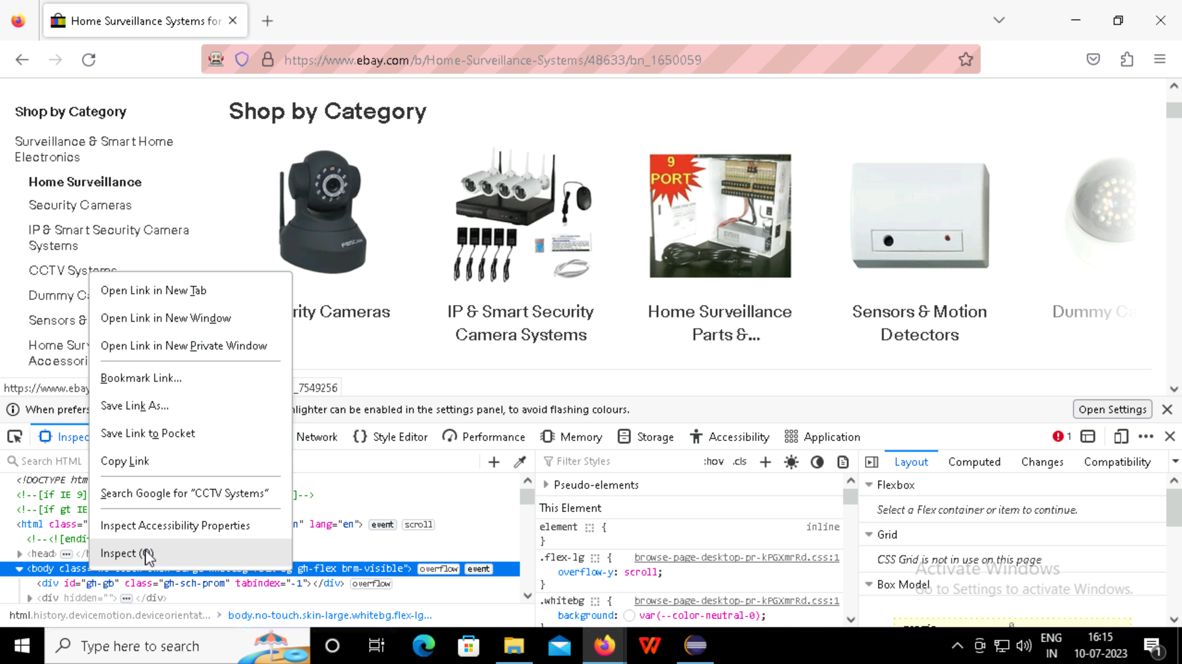

Slide 35
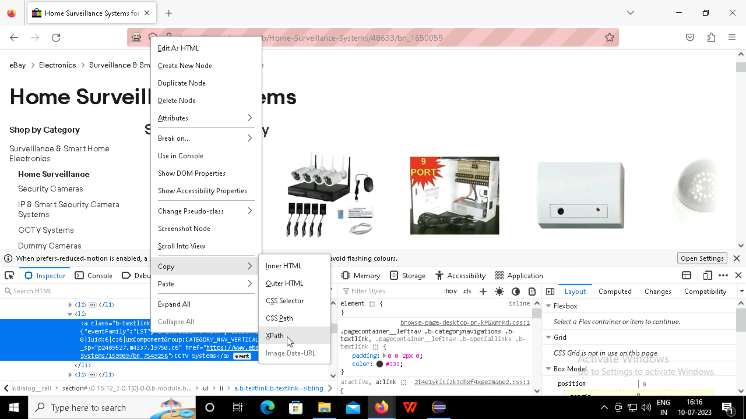

Slide 36
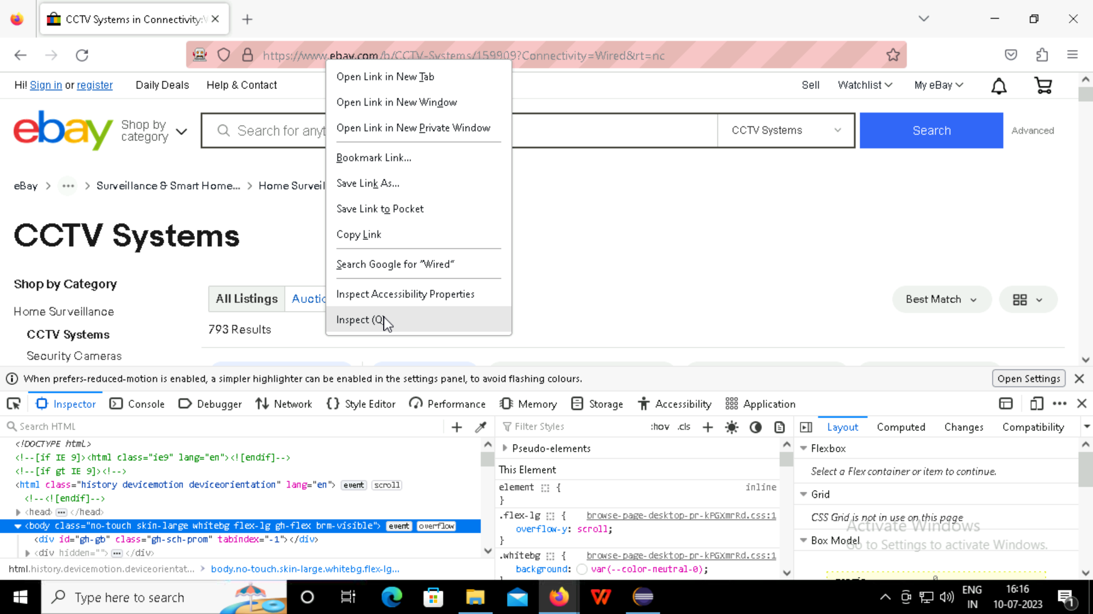

Slide 37
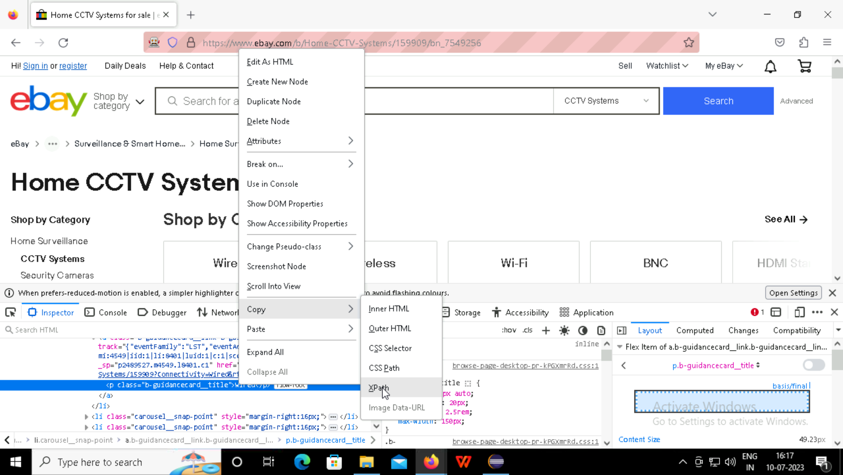

Slide 38
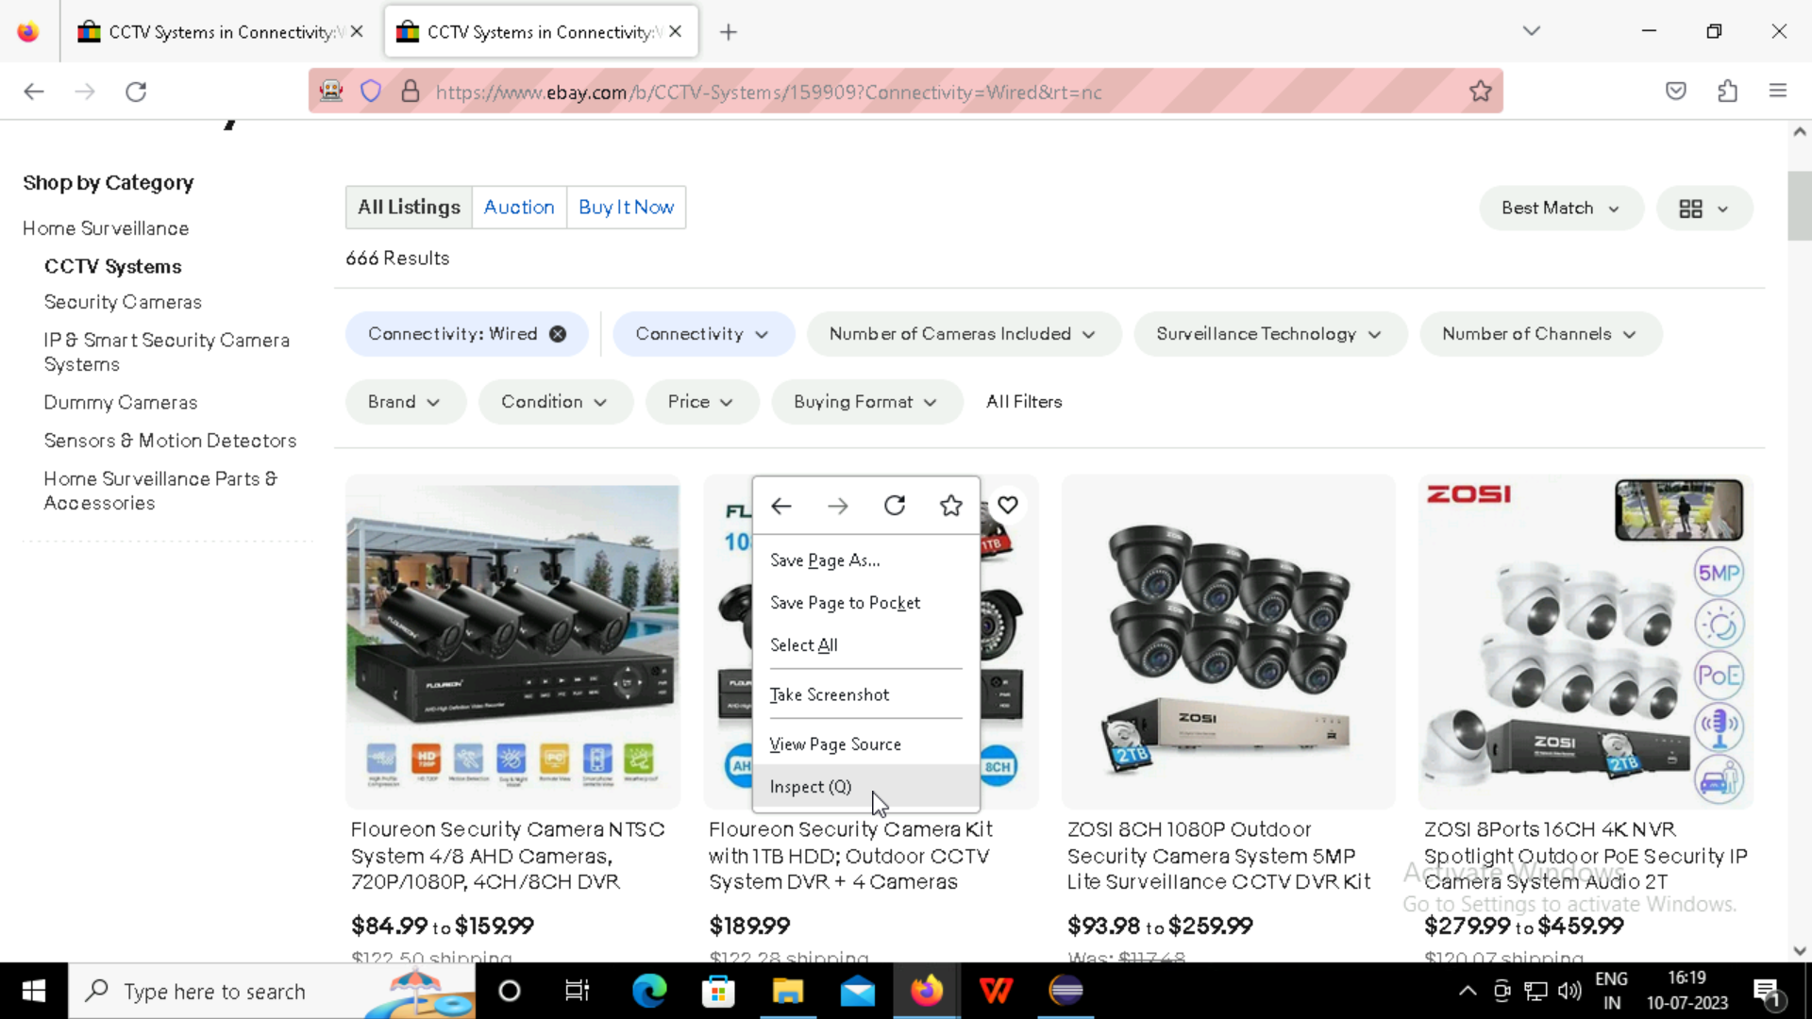

Slide 39
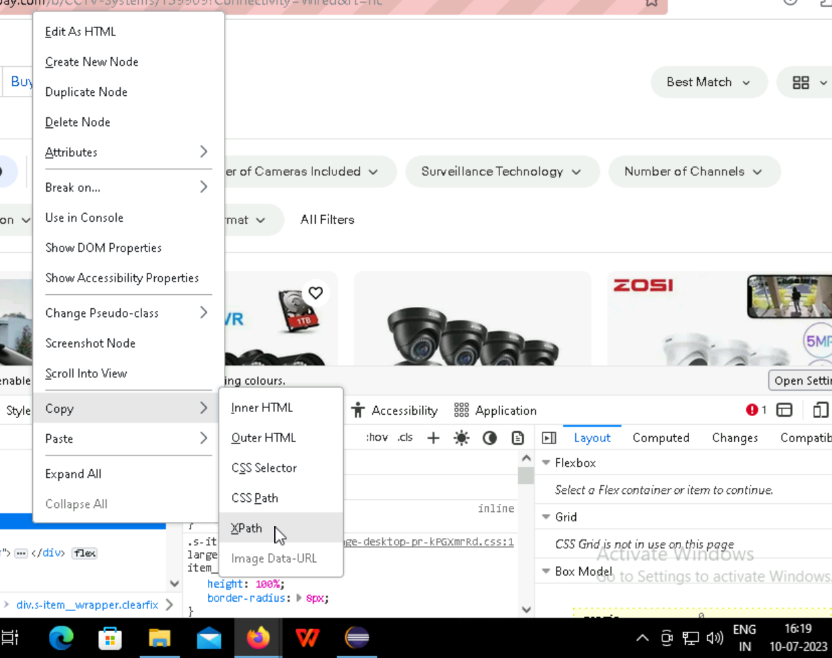
Coping the xpath of the security camera

Slide 40
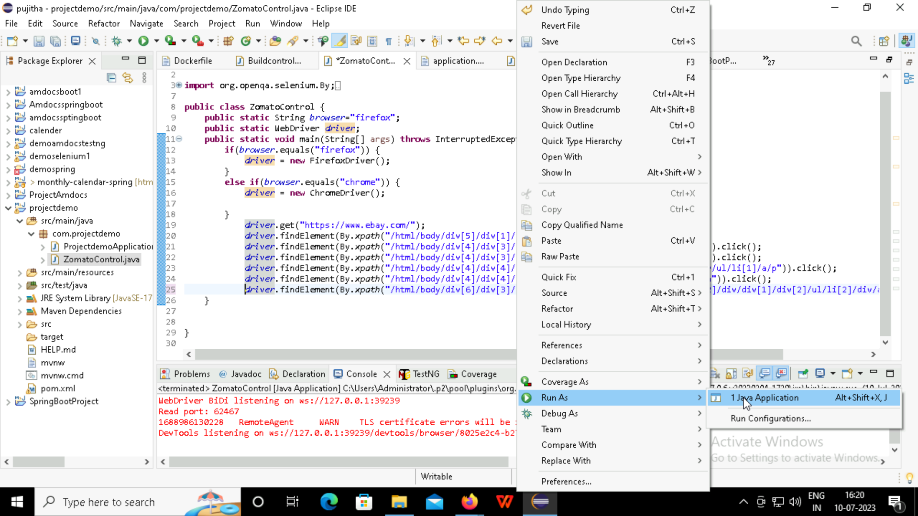

Slide 41
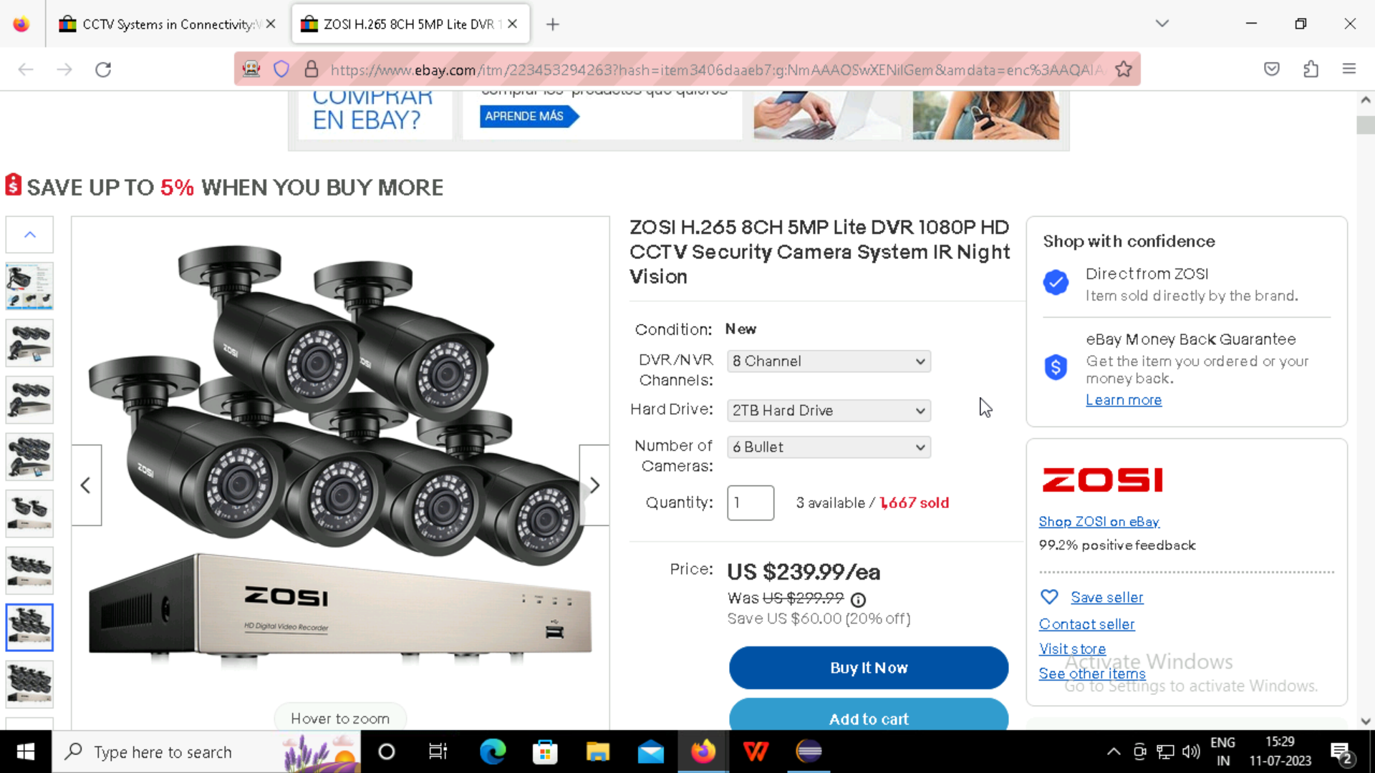

Slide 42
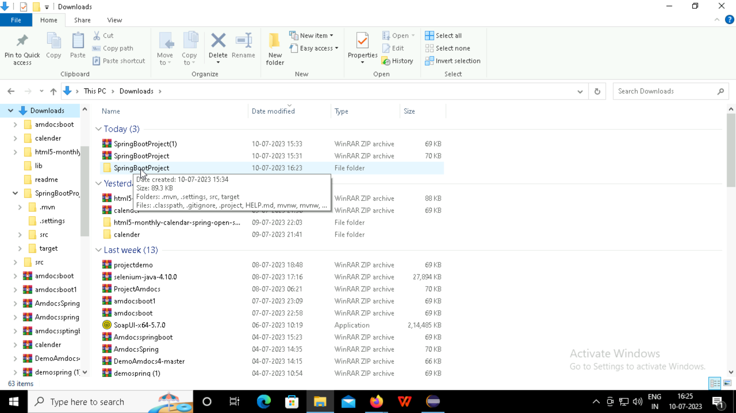

Slide 43
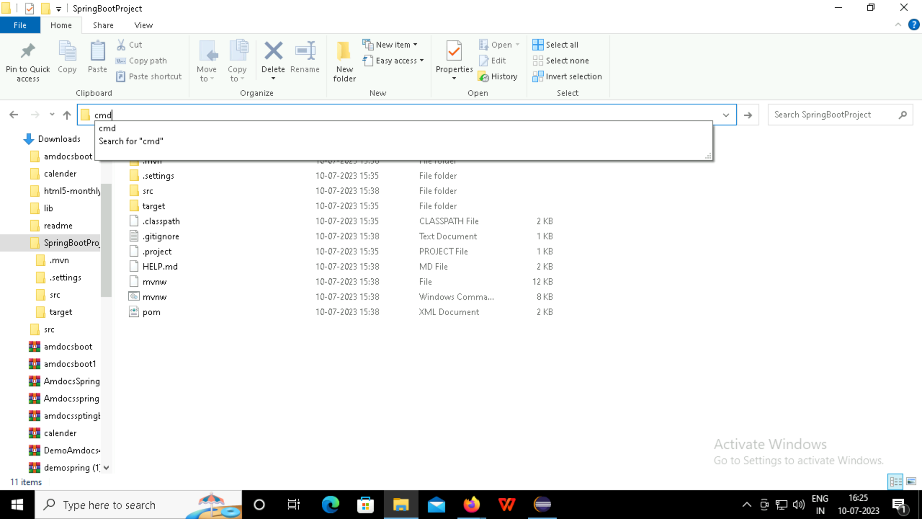

Slide 44
Git-Hub GitHub is a code hosting platform for version control and collaboration

Slide 45
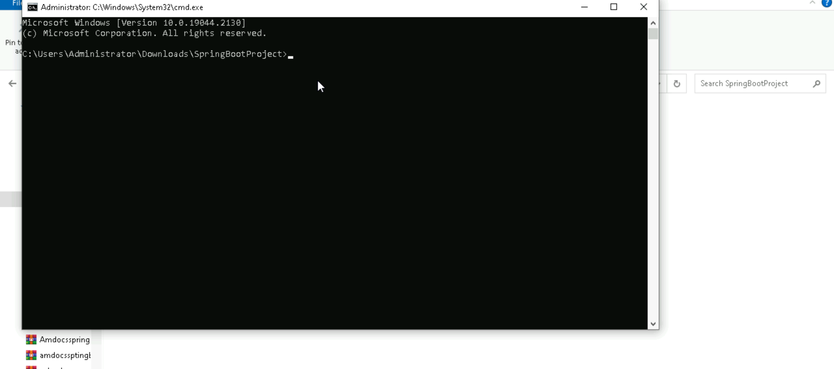
Initialize the git hub with the command git init

Slide 46


Slide 47
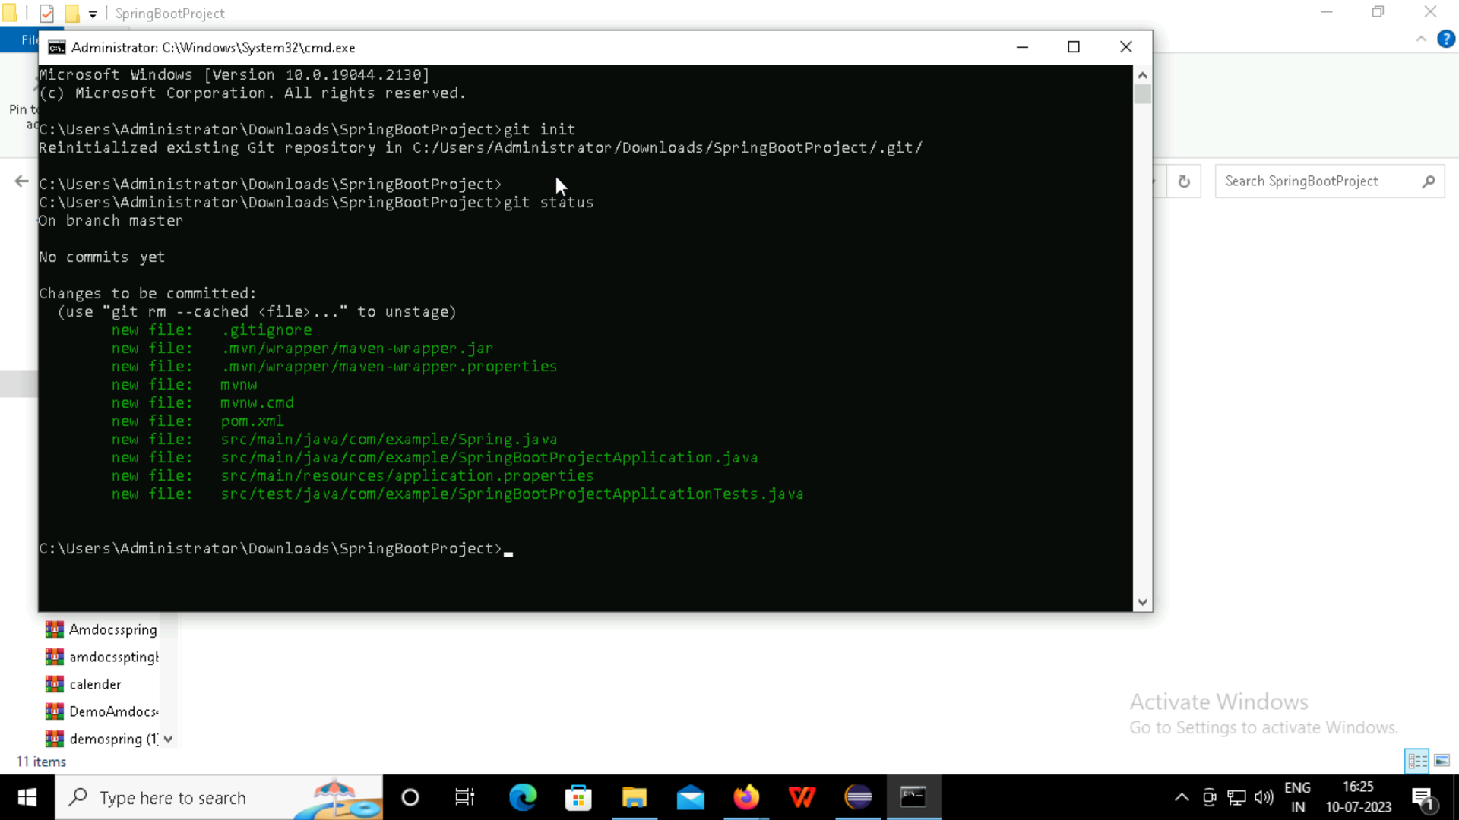
Checking the git status

Slide 48

Then we need add some file by using the git add .
Again check the status of the git

Slide 49
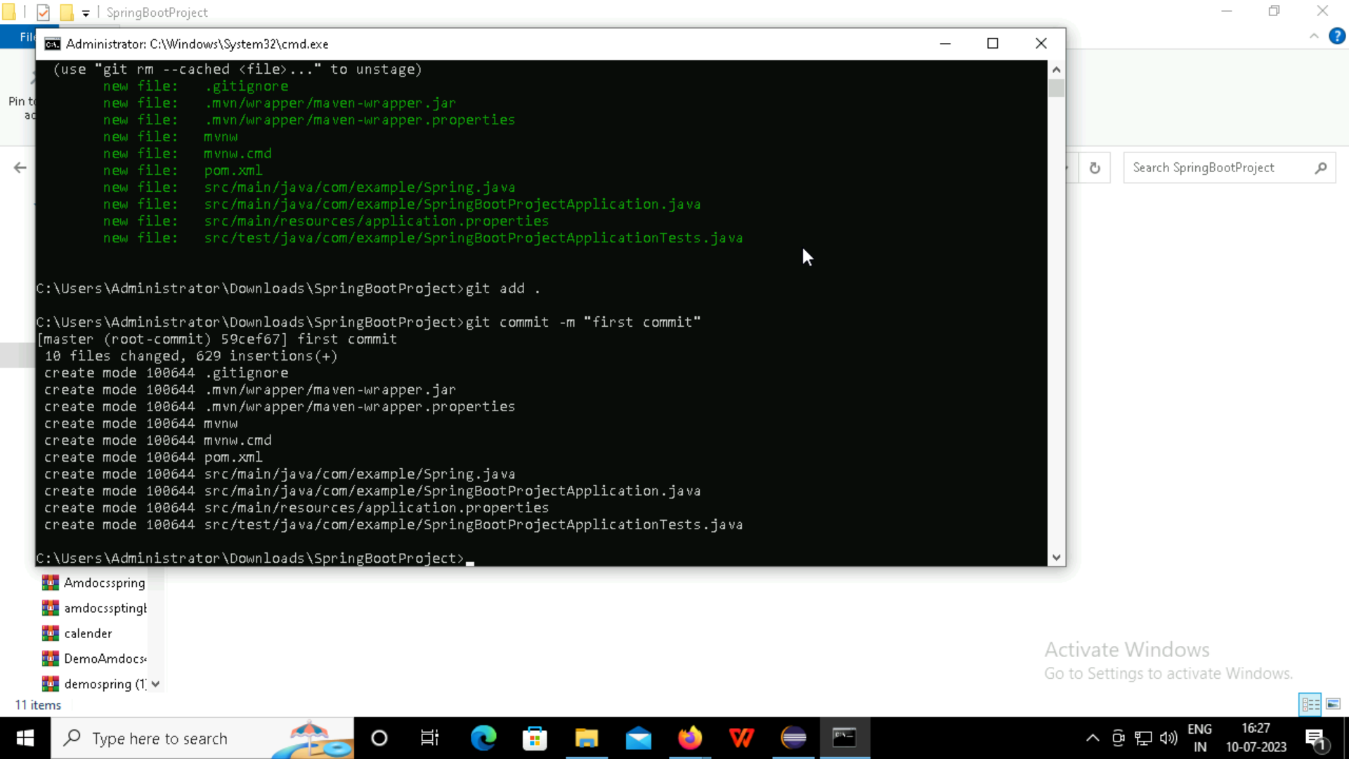
Check the commit met by the git

Slide 50
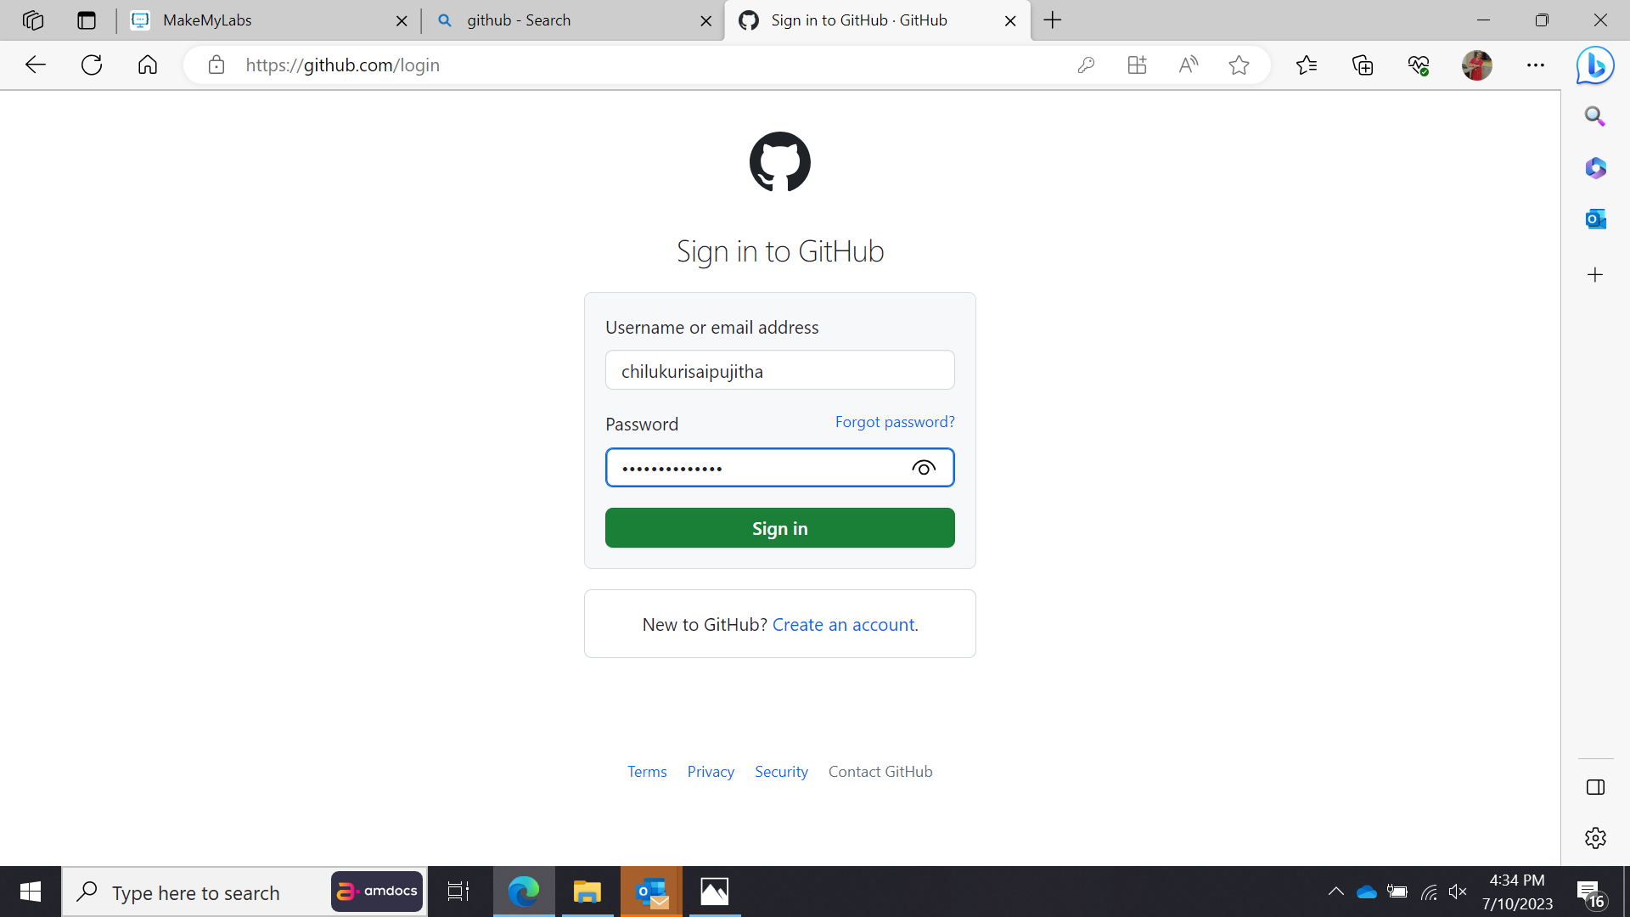
Login to git-hub

Slide 51
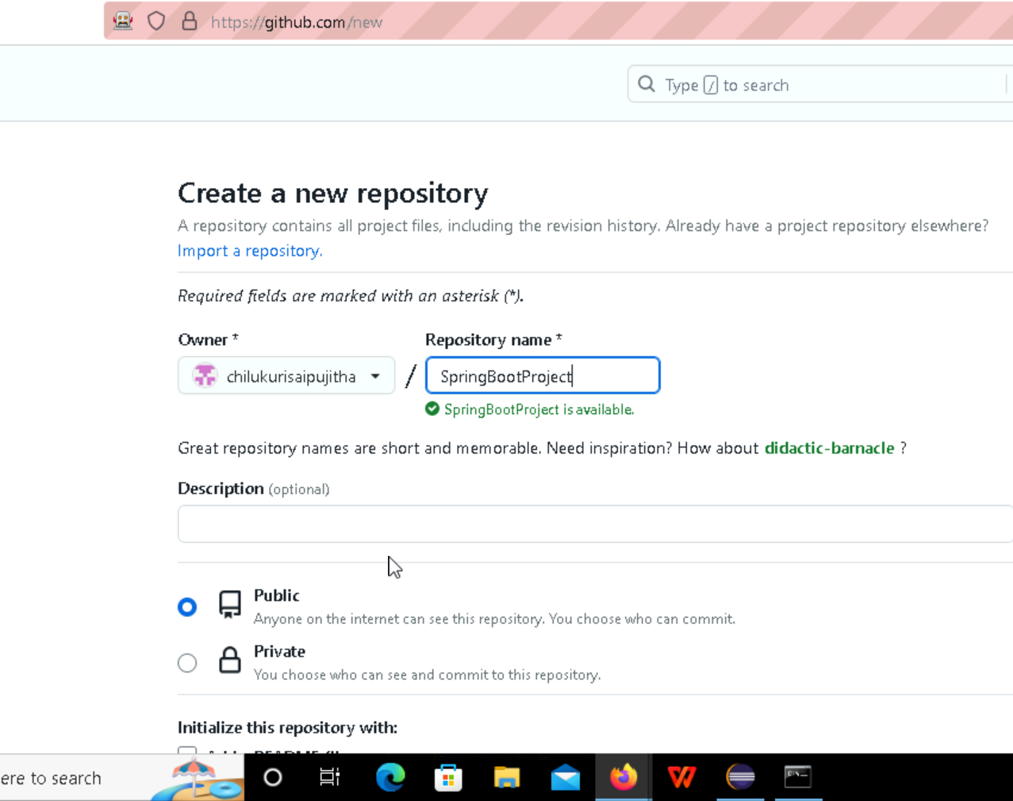
Creating the repository in the git-hub to push the data from eclipse to git-hub

Slide 52
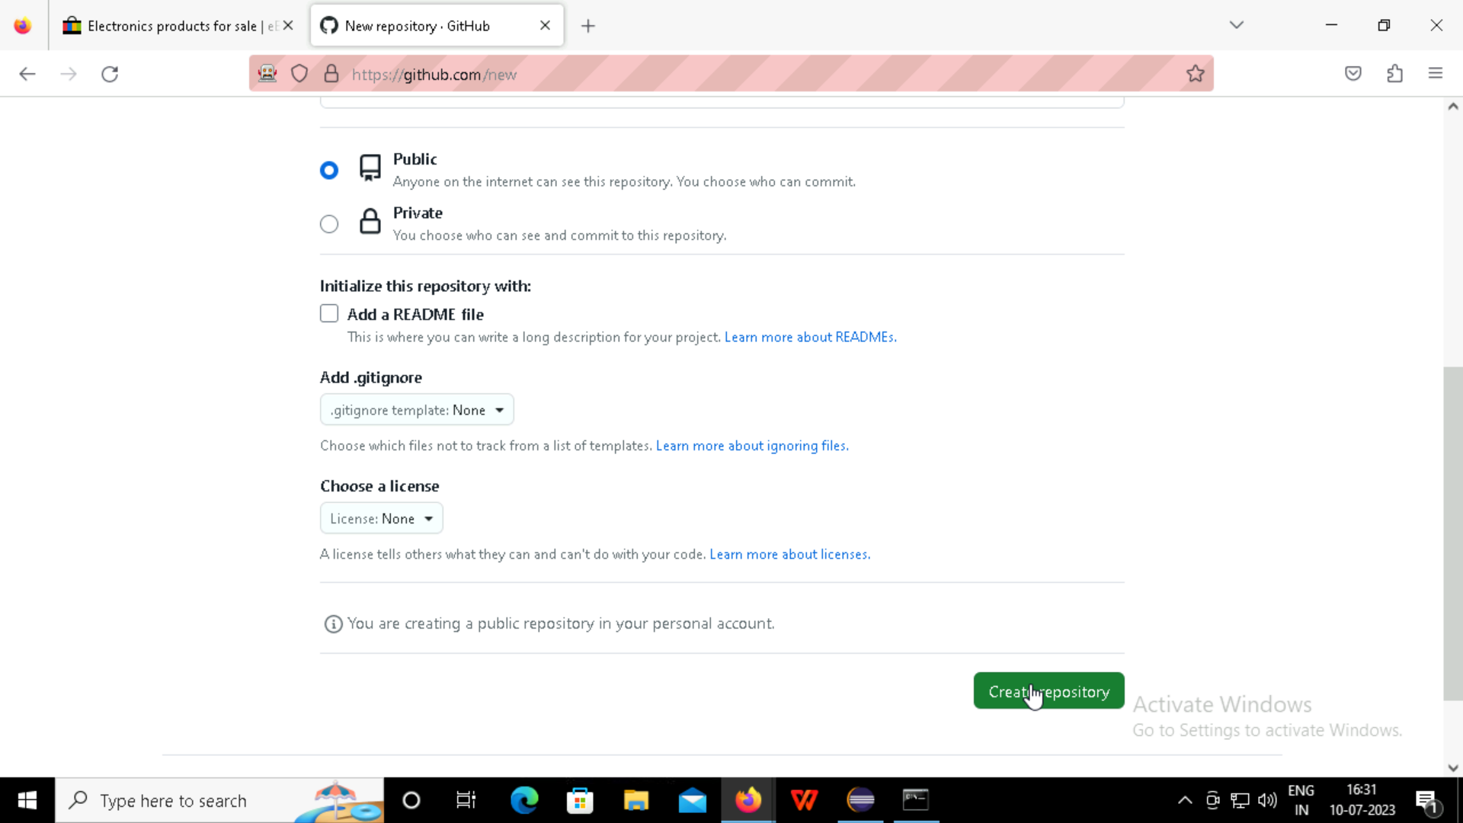

Slide 53
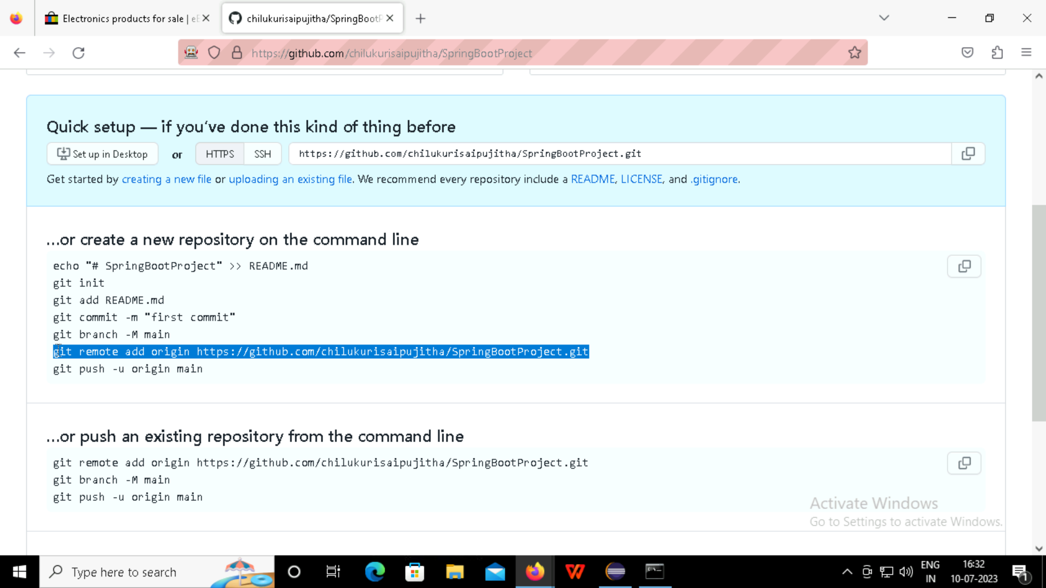

Slide 54
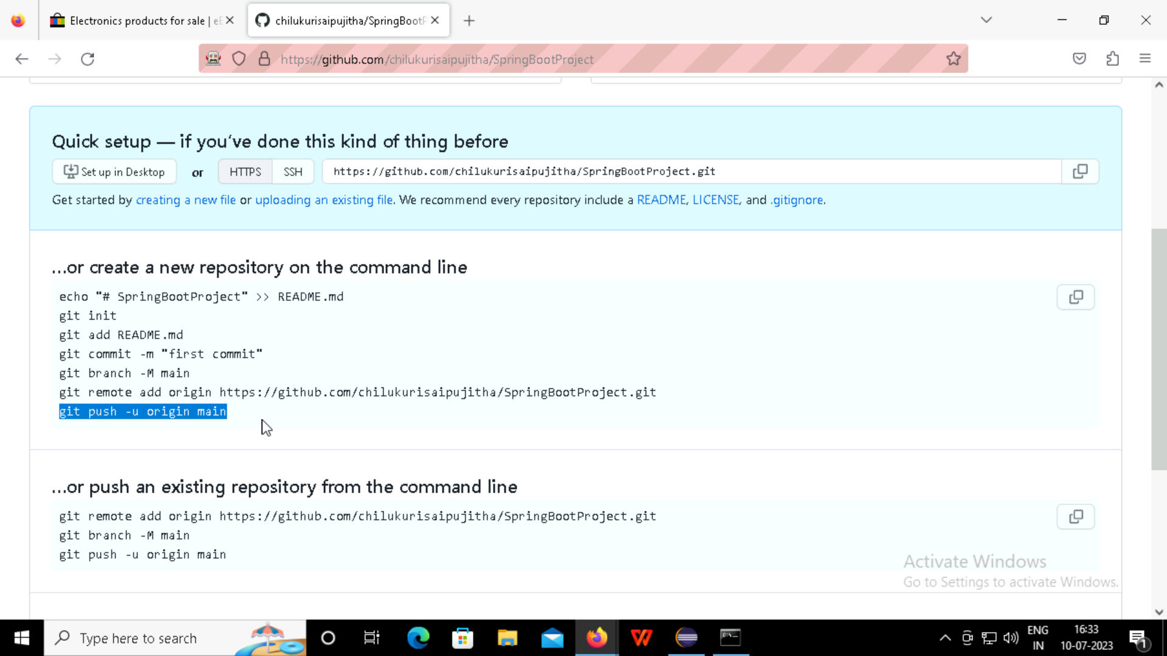

Slide 55
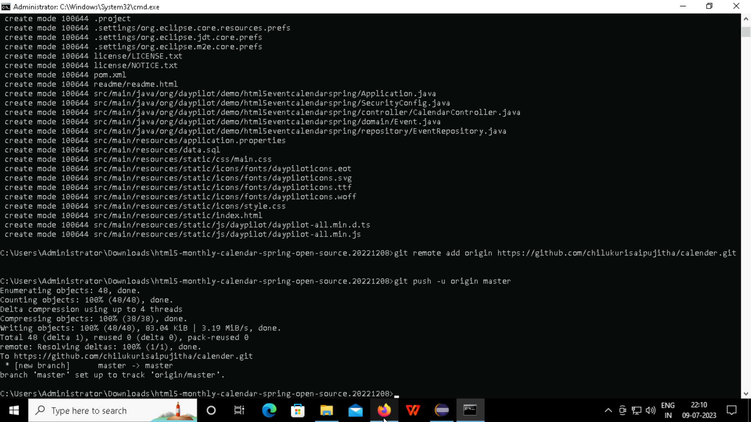

Slide 56
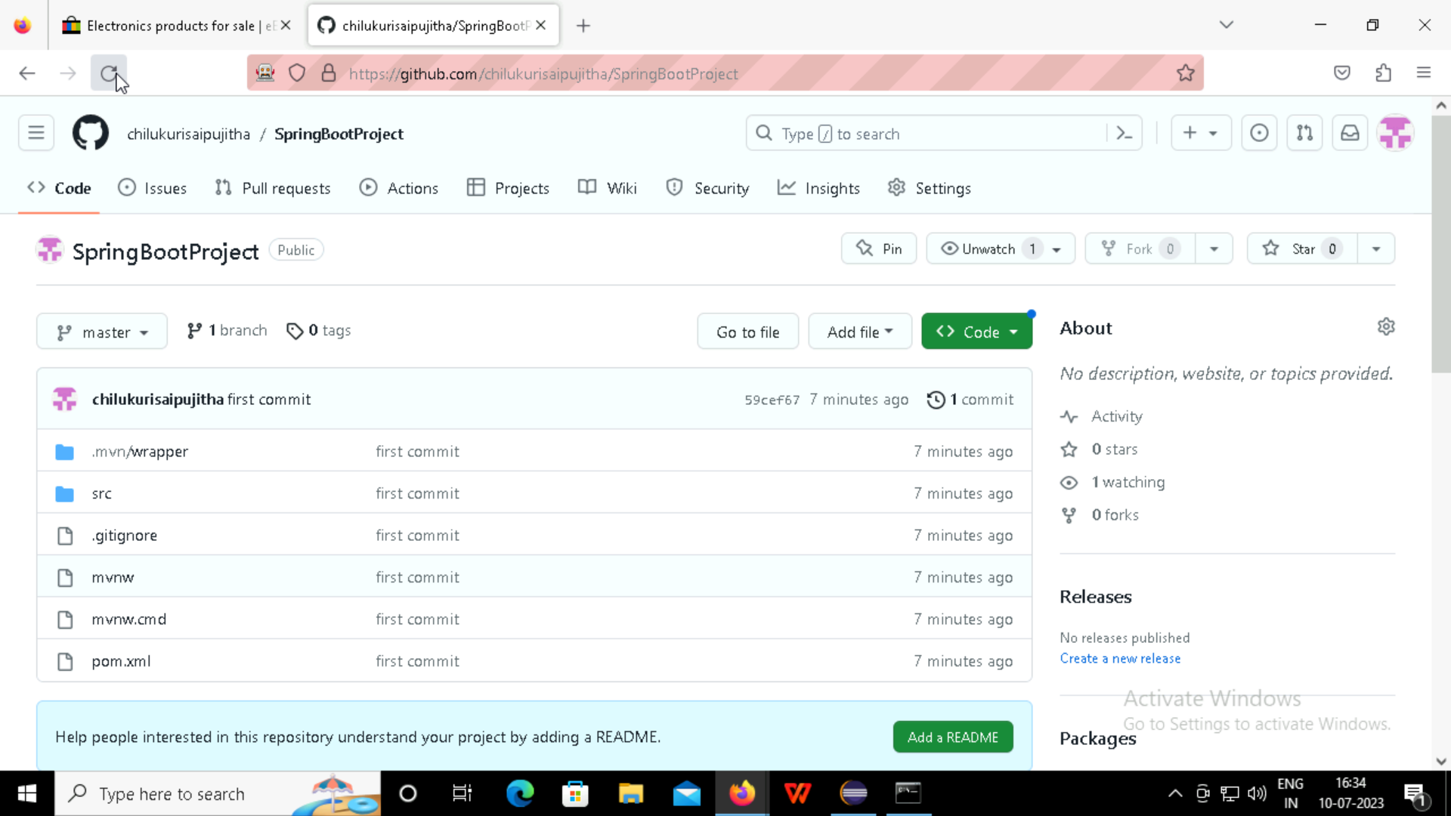
Spring Boot project pushed into the git-hub

Slide 57
JENKINS

Slide 58
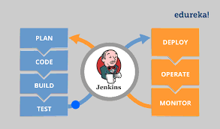
Jenkins
Jenkins is an automation tool that is open-sourced and written in Java and has pluginJs built for continuous integration
Jenkins is an opensource continuous integration/continuous delivery

Slide 59
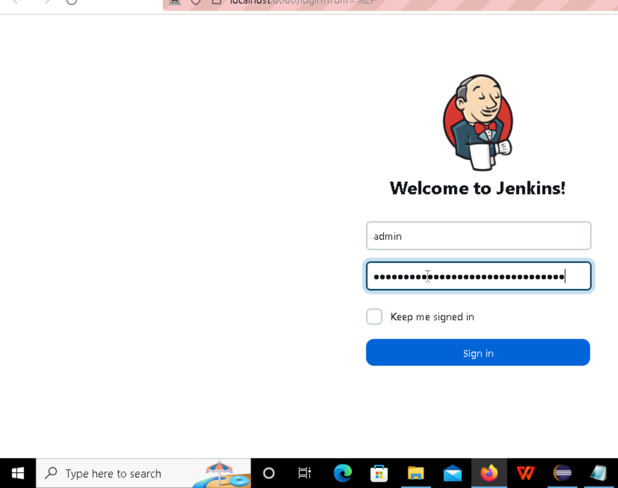
Login to Jenkins

Slide 60
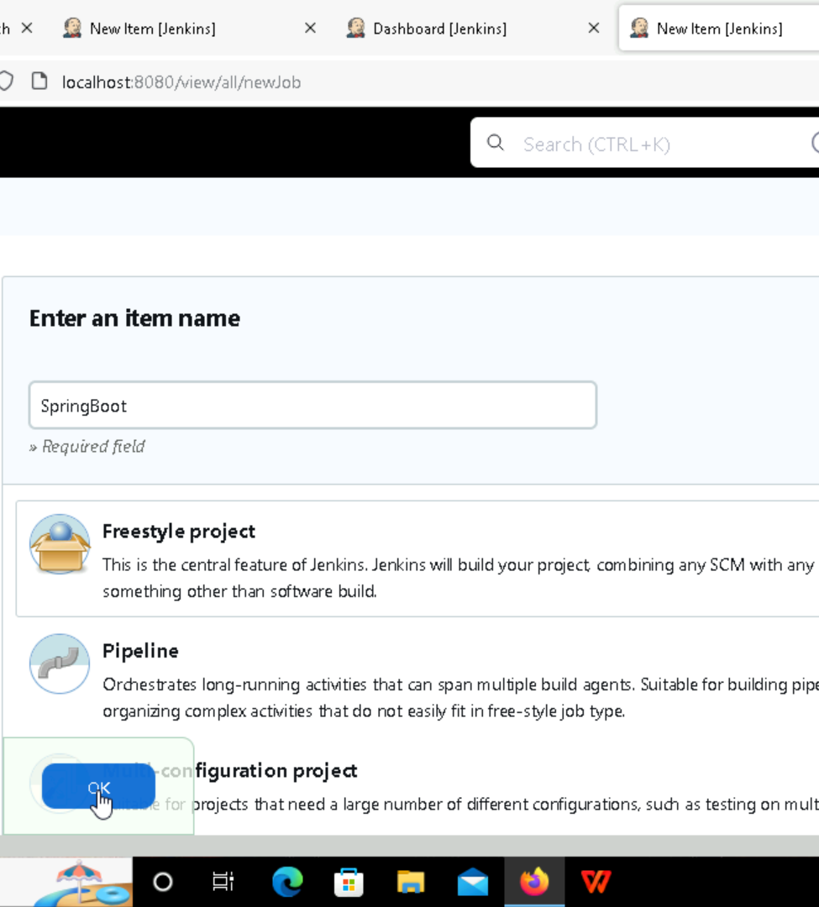
Creating a free style project in Jenkins

Slide 61


Slide 62

Copy the Git-hub URL

Slide 63

Select the git-hub

Slide 64

Pasteing the URL of the Spring Boot Project and giving the login Credentials of the git-hub

Slide 65


Slide 66


Slide 67


Slide 68

Adding The Build Path

Slide 69


Slide 70

Save The Configure

Slide 71


Slide 72

Building the output

Slide 73

Thank you

